Slide 1

The prosody of independent and dependent clauses with ha 'if' and mintha 'as if' in Hungarian (pilot study)
The 14th International Congress for Finno-Ugric Studies (CIFU), August 19 2025, Tartu
DÉR, Csilla Ilona¹ & MARKÓ, Alexandra²
¹ ELTE Research Centre for Linguistics & Károli Gáspár University of the Reformed Church
² MTA – ELTE Research Centre for Linguistics, Lendület Neurophonetics Research Group

Slide 2
Insubordinate (independent) clauses
Insubordinate clauses:
look like subordinate clauses (subordinate conjunction, subjunctive mode)
conventionalized as independent (main) clauses in language use (Evans 2007)
carry a specific pragmatic meaning (e.g. interpersonal, modal, discoursive)
I. Syntactically independent: elaborative/discourse-connective insubordinate clauses
(1) Mondtam hagyjon engem békét ilyen hülyeségekkel, hogy 25 évig ez, az, amaz, amit most mar beolvastak nekem, hogy mi van az interneten. Hogy mi a véleményem? Alig tudok szóhoz jutni.
conj what the opinion.Poss.1Sg
’I said he should leave me alone with such stupid things that this and that for 25 years, that they read out for me now, that is on the internet. What is my opinion? I can hardly say a word. (MNSz2, doc #2597, spok)
Notes:
Our presentation addresses the intonation of Hungarian conditional insubordinate clauses, in comparison with syntactically dependent variants containing the same subordinate clause.
Insubordinate clauses can be defined as clauses that: (1) … (2) … (3) ….
The main parameter along which they are typically classified is their syntactic and/or pragmatic dependency.

Slide 3
Classification of insubordinate clauses
II. Stand-alones (performatives): syntactically and pragmatically independent
Complement insubordination: introduced by ’that’ (that, dass, que, etc.)
(2) Hogy ezt kell megérnem!
that this.acc have.to vpfx.live.inf.cond.sg1
‘That I had to live to see this!’
Conditional insubordination: introduced by conditional subordinators, ’if’ (if, wenn, als, etc.)
Protasis: if X (subordinate clause) [apodosis is missing or impossible to reconstruct]
(3) Ha azt csak úgy lehetett volna!
if that.acc only that.way may.pst be.cond
’If that could’ve just been done like that!’
Notes:
The other major group is formed by stand-alone insubordinate clauses.
The two subtypes of syntactically and pragmatically independent insubordinate clauses are complement and conditional insubordination

Slide 4
Intonation of insubordinate clauses
Spanish:
Elvira-García et al. (2017): [corpus + Discourse Completion Task, production of target sentences] si ’if’, como si ’as if’, para que ’so/in order that’ clauses: subordinate and elliptical clauses (that can recover the elided clause) show prosodic markings of continuation (rising boundary tones), insubordinated clauses don’t (falling patterns)
Elvira-García (2019): [two perceptual forced-choice discrimination tests: natural vs. synthetic stimuli] speakers link rising boundary tones with adverbial elliptical clauses, and have chosen the narrow focus contour for the insubordinate construction
Sánchez López (2019): [intonation patterns] que+V_{subj}: que-evaluatives: rising pitch in the first stressed syllable and a rising intonation movement at the end of the sentence; que-optatives: clear rising pitch in the first stressed syllable and a falling final intonation movement at the end of the sentence
Notes:
Research on the intonation of insubordinate clauses has primarily been conducted for Spanish. Elvira-García et al. (2017) found that subordinate and insubordinate versions of the same clauses differ in intonation.
2019 perception study confirmed this finding.
Sánchez López observed in certain que-insubordinate clauses that …

Slide 5
Intonation of insubordinate clauses
Czech (Fried & Machač 2022): spontaneous conversations, jestli ’if’
Insubordinate clauses with different epistemic function (counter-argument construction vs. potential explanation construction) have different intonational contour (conclusive falling cadence vs. slightly rising contour)
The intonational profile of insubordinate constructions more closely resembles that of embedded (non-insubordinate) constructions with the same epistemic function than that of the other insubordinate type (the intonation indicates directly the speaker’s confidence in the truth of a given proposition).
Italian (Lombardi Vallauri 2016): spoken vs. written Italian
se ’if’ free conditionals with different pragmatic functions (invitation/offer/request, generic question: ’what will happen?’; ’there is nothing to do’, protest) are marked by (different) characteristic intonational contours
”Italian free conditionals are no longer limited to having a suspended, ‘not concluded’ intonational contour, which would be the case for conditionals whose apodosis [main clause] is not produced on contingent grounds; and that their specialization for the mentioned pragmatic functions is fully instantiated by the language, including appropriate intonation” (p. 162)
the type of speech act determines the intonation
Notes:
Fried and Machač (2022) examined conditional insubordinate clauses in Czech. They found that insubordinate clauses containing this conjunction and have different epistemic function…
Finally, in his overview of the intonation of Italian conditional insubordinate clauses, Lombardi Vallauri concluded that …

Slide 6
Research question/hypothesis
Conditional (ha ’if’) and hypothetical/counterfactual conditional (mintha ’as if’) clauses
We expect differences in the intonation of stand-alone insubordinate and subordinate variants of the same clause (example 10):
Insubordinate variant (stand-alone type), e.g.
Barátod: – Biztos úgy akart tenni, mint aki keni-vágja, mi az a kvantum-összefonódás. Te: – Mintha tudná…
Friend: “They were probably trying to act like they really understand quantum entanglement.” You: “As if s/he knew…”
2. Subordinate variant with an elided but syntactically recoverable main clause, e.g.
Barátod: – Hogy beszélt tegnap az ismerősöd a kvantumfizikáról? Te: – Mintha tudná.
Friend: “How did your acquaintance talk about quantum physics yesterday?” You: “As if s/he knew.”
Notes:
Our investigation focused on Hungarian conditional and conditional comparative insubordinate clauses (Category 1).
Our main hypothesis is that their intonation would differ from that of identical but elliptical clauses (i.e., clauses whose main clause is syntactically recoverable but not realized) (Category 2).
To illustrate with the example mintha tudná (“as if he/she knew”):

Slide 7
Research question/hypothesis
3. Biclausal complex sentence, in which the subordinate clause is identical to that found in 1. and 2., e. g.
Barátod: – Hogy beszélt tegnap az ismerősöd a kvantumfizikáról? Te: – Úgy beszélt a kvantumfizikáról, mintha tudná.
Friend: “How did your acquaintance talk about quantum physics yesterday?” You: “They talked about quantum physics as if they knew.”
b. Barátod: – Hogy beszélt tegnap az ismerősöd a kvantumfizikáról? Te: – Mintha tudná, úgy beszélt a kvantumfizikáról.
Friend: “How did your acquaintance talk about quantum physics yesterday?” You: “As if they knew, that’s how they talked about quantum physics.”
Notes:
Likewise, we expected an intonational difference between these insubordinate clauses and their bi-clausal complex subordination counterparts containing the same subordinate clause.

Slide 8
Material & method
1d.
Egy barátod ideges amiatt, mert egy valószerűtlen hírt kell közölnie egy rokonával. Nyugtasd meg, hogy ha mástól nem is hinné el az a rokona a hírt, neki biztosan el fogja:
– Biztosan igaz a hír, ha te mondod.
’A friend of yours is anxious because they have to share an implausible piece of news with a relative. Reassure them that even if their relative wouldn’t believe it from anyone else, they would believe it from them:
– It must be true, if you say so.’
Notes:
We recruited 30 secondary school and undergraduate university students (16–26 years, mean: 21.1 y, 24 (80%) females, 6 males) and sent them individualized PowerPoint presentations via email. Each presentation contained one version of each of the ten target sentences, representing one of the following structural types:
either an insubordinate clause,
or an subordinate clause with an ellipted main clause,
or a biclausal complex sentence with the subordinate clause in initial or final position.
Participants were instructed to produce each sentence aloud as part of a conversational scenario, following the prompts provided. For example, in the case of sentence 1d.
The participants recorded the sentences on their mobile phones and sent the audio files back to us. In this way, for each of the ten sentences, we collected 4 to 8 different participant productions. We excluded any instances where participants clearly misunderstood the instructions or misinterpreted the emotional or pragmatic context.

Slide 9
Material & method
7a.
Egy barátoddal megpróbáltok rájönni, miért nem működik a mikróhullámú sütőd. Ő nekiállna szétszedni, te kételkedve-gúnyosan kommentálod az észrevételét, jelezve, hogy tudod, kifejezetten ügyetlen a műszaki eszközök megszerelésében:
Barátod: – Szerintem ezt itt ki kell csavarozni belőle.
Te: – Mintha értenél hozzá…
’You and a friend are trying to figure out why your microwave oven isn't working. Your friend is about to start taking it apart, and you respond with a sarcastic-doubtful comment, implying that you know they are particularly clumsy when it comes to repairing technical devices.
Your friend: I think we need to unscrew this part here.
You: As if you knew what you were doing…’
Notes:
Another example, 7a contains an insubordinate variant of Mintha értenél hozzá.

Slide 10
Material & method
Insubordinate sentences: assertives, evaluations (+negative-positive emotions), wishes
1. Ha te mondod… [assertive, sarcastic-sceptic]
if you say.2sg
’If you say so…’
2. Ha nekem ilyen telefonom lenne… [wish]
if me.dat such phone.Poss.1sg be.cond.3sg
’If only I had a phone like that…’
3. Ha van felesleges pénzkidobás… [assertive, strong declaration)
if be.3sg pointless waste.of.money
’If there’s such a thing as a pointless waste of money…’
Notes:
This and the following slide present the conditional and conditional comparative insubordinate clauses examined.
These also include highly lexicalised constructions, e.g., (1).

Slide 11
Material & method
4. Ha ez nem rögeszme… [assertive, ’I think the opposite of it’]
if this not obsession
’If this isn’t an obsession…’
5. Ha kivennéd a mélyhűtőből a csirkét… [request]
if take.out.cond.2sg the freezer.elat the chicken.acc
’If you could take the chicken out of the freezer…’
6. Ha tudná… [evaluation, worry, fear]
if know.cond.tr.3sg
’If s/he only knew…’
7. Mintha értenél hozzá… [assertive, sarcastic-sceptic]
as.if know.about.cond.2sg it.all
’As if you knew what you were doing…’

Slide 12
Material&method
8. Mintha válaszoltam volna… [assertive, conviction, certainty]
as.if answer.pst.1sg be.cond.3sg
’As if I did respond…’
9. Mintha nem tudná… [assertive, sarcastic-sceptic]
as.if not know.cond.tr.3sg
’As if s/he didn’t know…’
10. Mintha tudná… [assertive, sarcastic-sceptic]
as.if know.cond.tr.3sg
’ As if s/he knew…’
Notes:
Sentences (9) and (10) are of this type as well („set phrases”).

Slide 13
RESULTS
Notes:
As presenting the results for all ten sentences and all of their variants would be too lengthy, we focus here on the main findings for the insubordinate variants.
Of the four mintha-conjunction sentences (7–8–9–10), we present one example (10), as they all proved to be highly similar in terms of intonation. The analyses for the remaining sentences are also available on my slides, should anyone be interested.

Slide 14
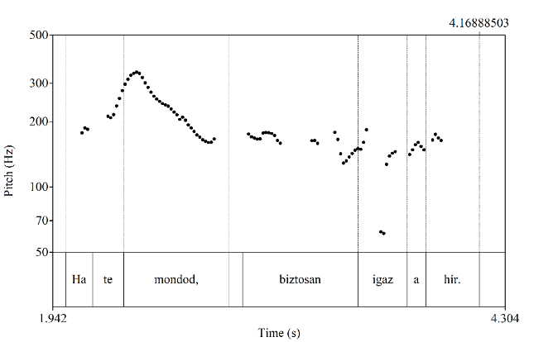
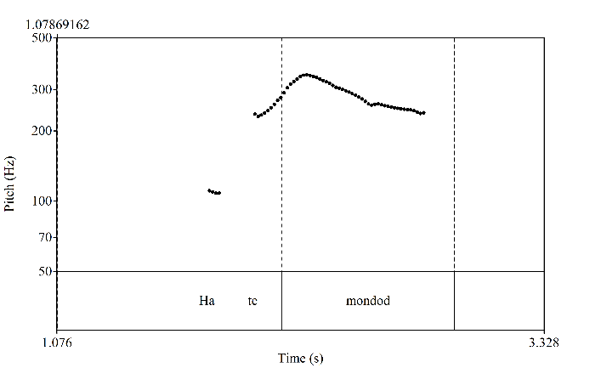
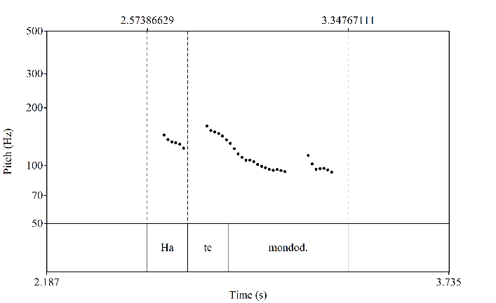
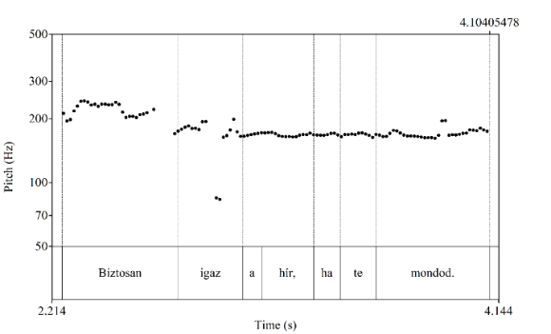
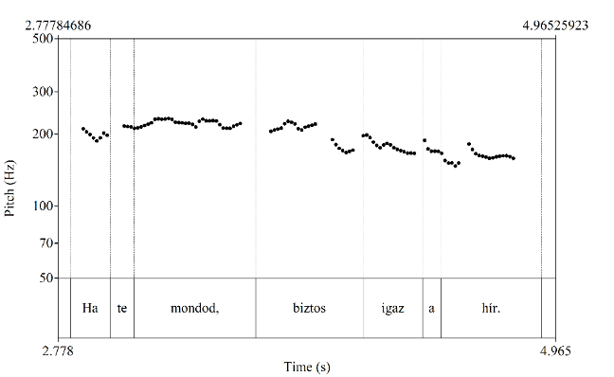
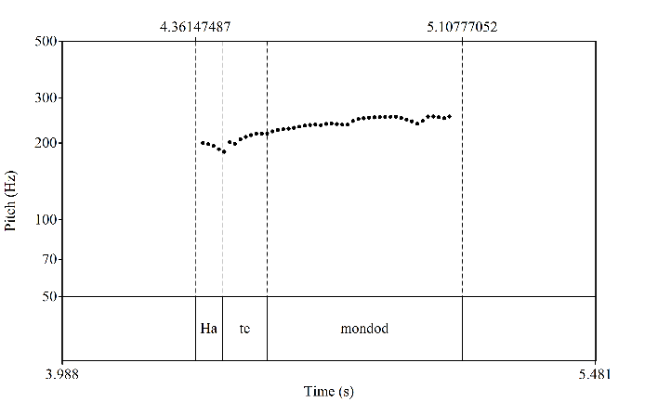
1. Ha te mondod… [sarcastic-sceptic, assertive] if you say.2sg
’If you say so…’
Both subordinate and insubordinate clauses show prosodic markings of continuation, while the elliptical clauses don’t, and the stress patterns are also different.
SUBORDINATE, WITHOUT MAIN CLAUSE, CERTAINTY
SUBORDINATE, WITH MAIN CLAUSE, CERTAINTY
INSUBORDINATE, SARCASM (DOUBT)
Stress on the verb
Stress on the pronoun
Notes:
The subordinate version without main clause (ellipted version) (1c) expresses certainty, which is represented by the falling contour. The main stress is positioned on the preverbal pronoun.
If the clause appears as the second part of a biclausal complex sentence (1d), it is pronounced with a flat contour.
As the first clause of a complex sentence (1e), two versions can be detected: either a high tone with the stress on the verb, or flat contour, similarly to the first-clause realization.
The insubordinate version (1a) repeats these latter patterns: more frequently we see the high-tone realization but with less steep declination, or sometimes the flat or rising contour. Therefore, these insubordinate versions can be interpreted as open-ended complex sentences, where the hearer is invited to complete the sentence.

Slide 15
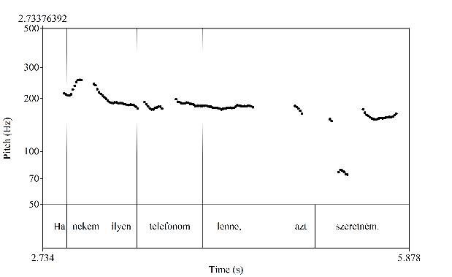
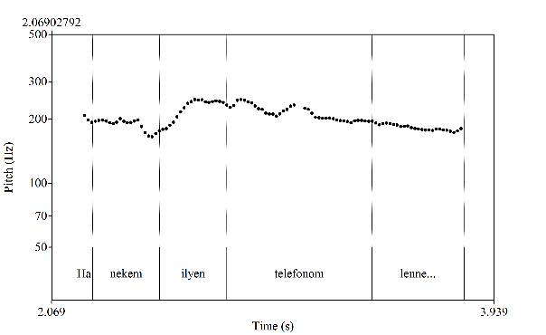
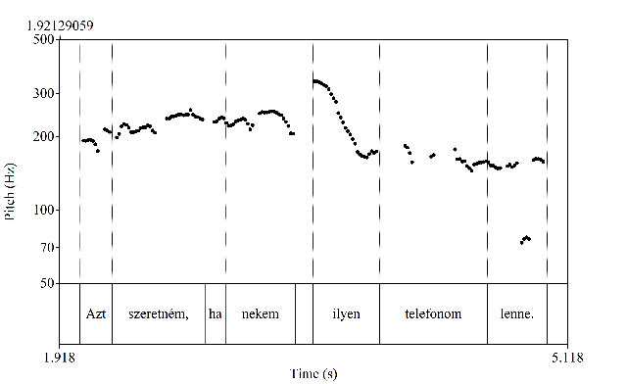
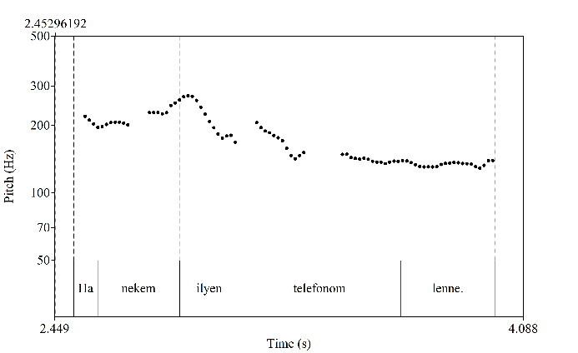
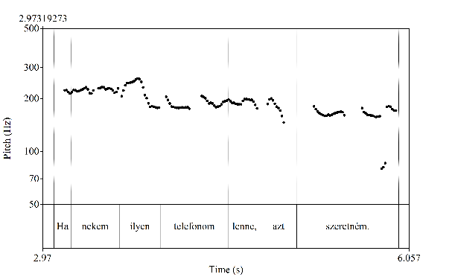
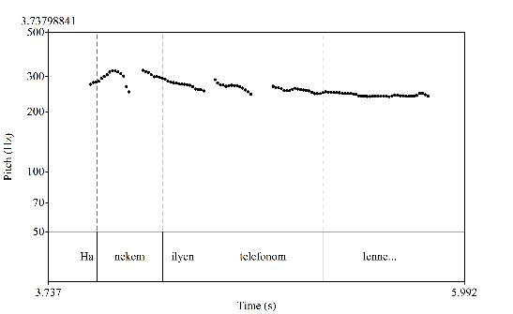
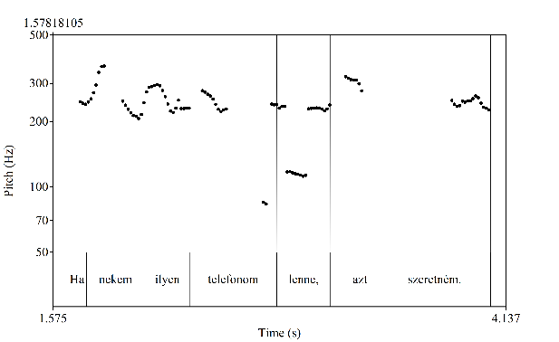
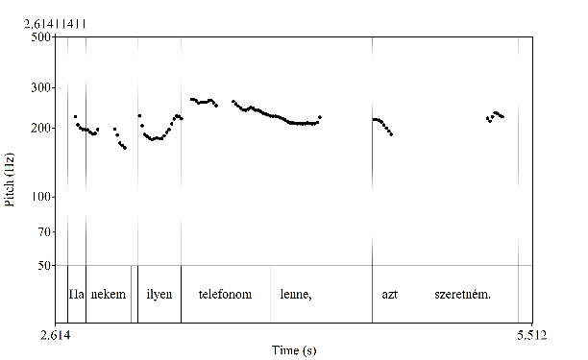
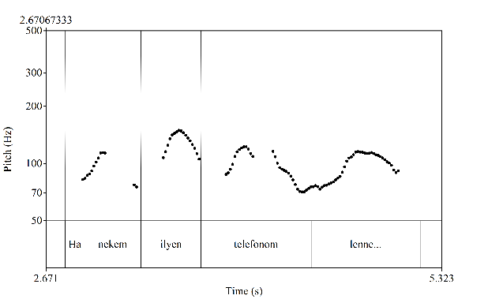
2. Ha nekem ilyen telefonom lenne… [wish] if me.dat such phone.Poss.1sg be.cond.3sg
’If only I had a phone like that…’
The prosodic pattern of elliptical construct is repeated in both subordinate and insubordinated clauses, but in the latter ones large variability is possible.
INSUBORDINATE, DESIRE
SUBORDINATE, WITHOUT MAIN CLAUSE, DESIRE
SUBORDINATE, WITH MAIN CLAUSE, DESIRE
nekem
ilyen
ilyen
nekem
telefonom
Notes:
In the subordinate version without main clause (2b), the main stress is positioned on ilyen ‘such’.
If the clause appears as the second part of a biclausal complex sentence (2c), it is pronounced with the same contour as the previous construct, with a high tone on ilyen.
As the first clause of a complex sentence (2c), various versions were found in our experiment: any and all of the content words can be realized with a high tone (so can be stressed), therefore depending on the speakers’ interpretation four different solutions appeared:
Ha nekem ilyen telefonom lenne.
Ha nekem ilyen telefonom lenne.
Ha nekem ilyen telefonom lenne.
Ha nekem ilyen telefonom lenne.
This prosodic variability is also present among the realizations of the insubordinate construct.
We can conclude again that insubordinate versions can be interpreted as open-ended complex sentences, repeating the prosodic patterns of the subordinate constructs.

Slide 16
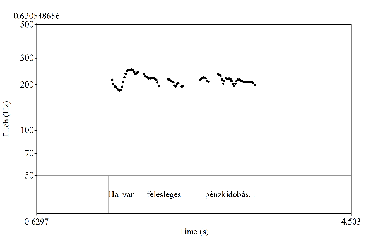
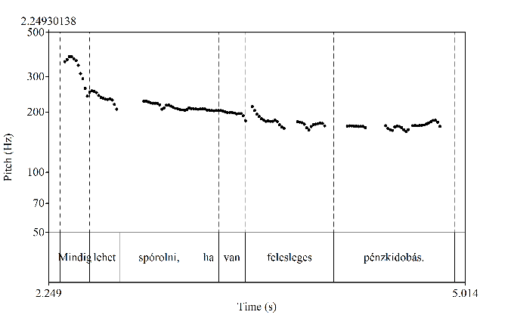
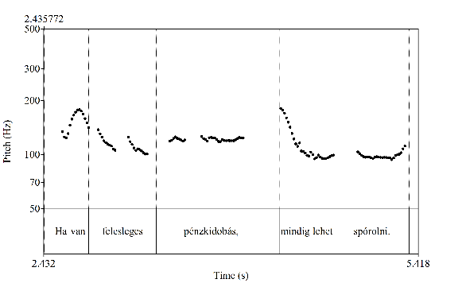
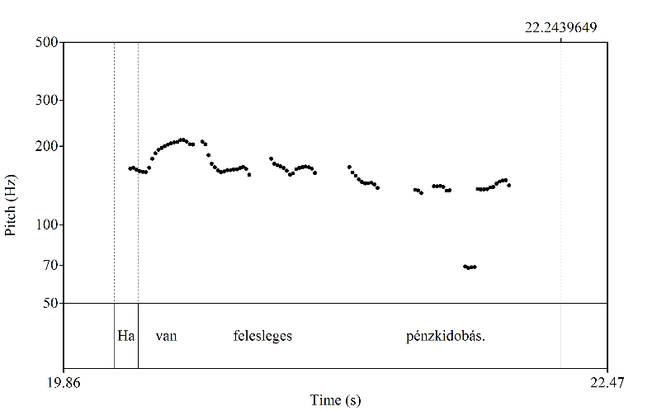
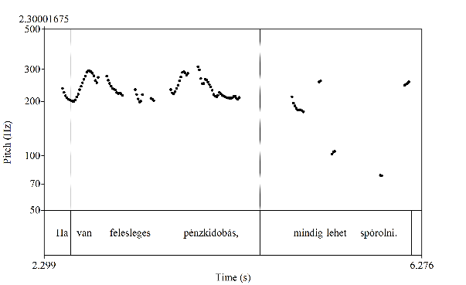
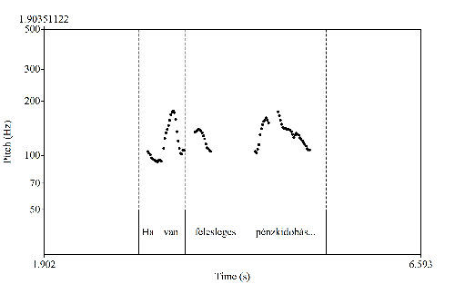
3. Ha van felesleges pénzkidobás… [assertive, strong declaration] if be.3sg pointless waste.of.money
’If there’s such a thing as a pointless waste of money…’
The prosodic pattern of the srdinate construct is repeated in the insubordinate clauses, with similar variability, no particular prosodic cue for insubordination.
SUBORDINATE, WITHOUT MAIN CLAUSE, NON-ASSERTIVE
SUBORDINATE, WITH MAIN CLAUSE, NON-ASSERTIVE
INSUBORDINATE, ASSERTIVE
No experimental data.
The most participants interpreted it as an insubordinate construct, the recorded samples are not conclusive.
v
EXPECTED
Notes:
Unfortunately, we couldn’t record sufficient material for the first construct (3c), therefore we show the prosodic realization in the pronunciation of the second author.
This pattern is repeated more or less both in the „subordinate with main clause” sentence types (3d, 3e) and in the insubordinate (3a) construct.
The subordinate and the insubordinate constructs show the same tendencies, as we have seen in the previous samples: in the first clause of a complex sentence (3e), various versions were found, which were repeated in the insubordinate construct. On the basis of the prosodic similarity of subordinate and insubordinate constructs (3a) we can conclude that the extra meaning of insubordinate type („strong declaration/opinion”) is incorporated into the construct’s basic meaning.

Slide 17
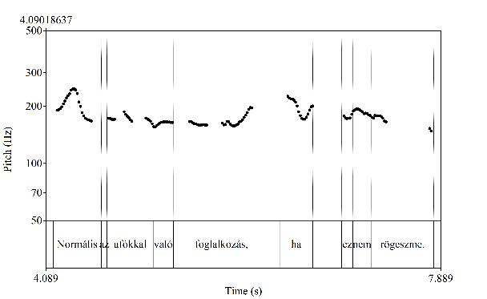
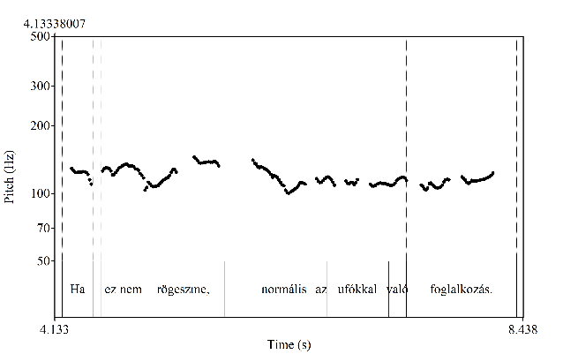
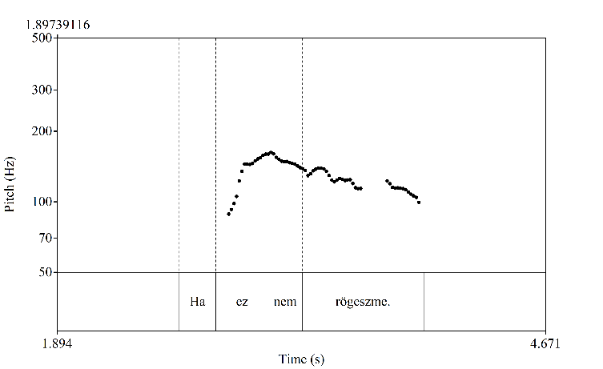
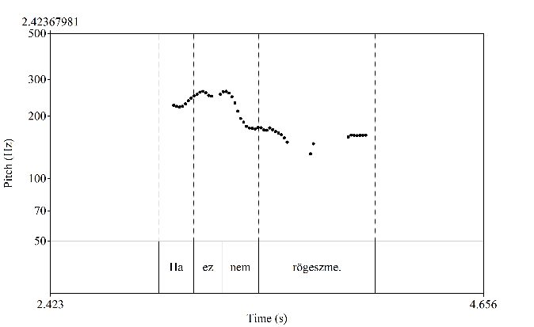
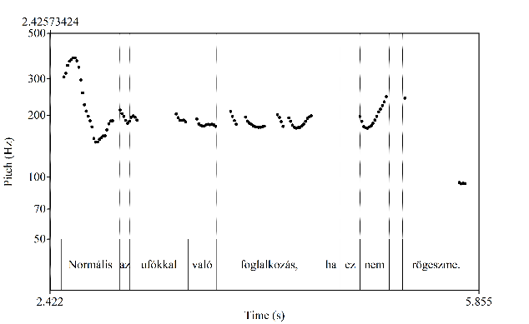
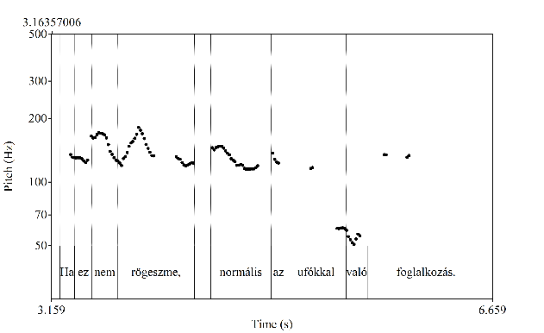
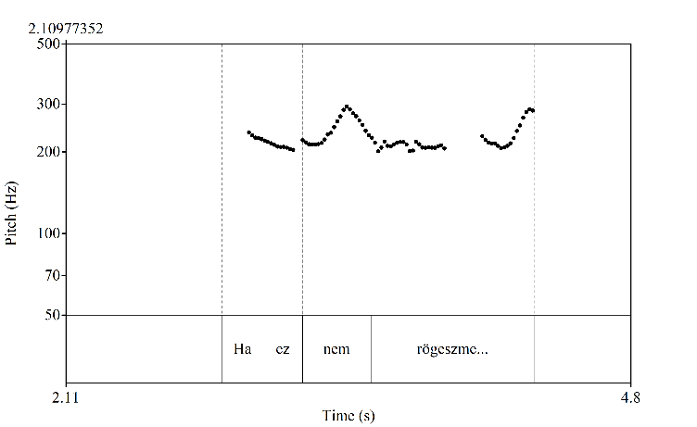
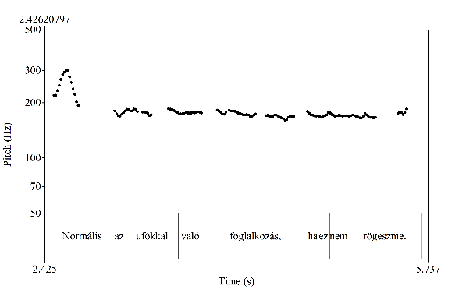
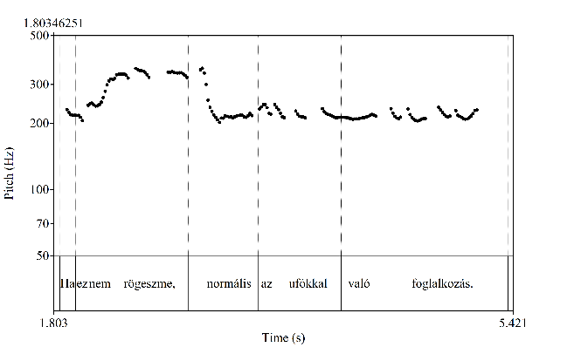
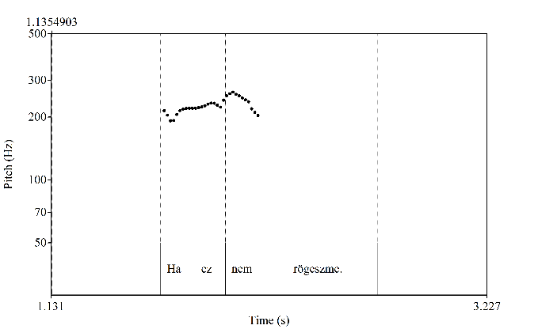
4. Ha ez nem rögeszme… [assertive, ’I think the opposite of it’] if this not obsession
’If this isn’t an obsession…’
The prosodic patterns of the insubordinate clauses suggest incompleteness.
SUBORDINATE, WITH MAIN CLAUSE, NON-ASSERTIVE
SUBORDINATE, WITHOUT MAIN CLAUSE,
NON-ASSERTIVE
INSUBORDINATE, ASSERTIVE–NEGATIVE
v
Notes:
In the „subordinate without main clause” (elliptic, 4c) version of Ha ez nem rögeszme., two prosodic patterns were produced: in the first one both ez and nem were stressed, in the other one nem bears the main stress. At the end of the construct we found either a flat contour or glottalization, which is percipitated low pitch. We might suppose that the high tone on the negation word is an obligatory marker of this sentence type.
Among the subordinate realizations (4d, 4e), we find various solutions, again, with stress on the conditional conjunction ha or on the negation word, but also on rögeszme or more words together. As in the complex sentence all semantic elements are included, various nuances can be expressed.
However, in the insubordinated (4a) construct we found two versions, both of them suggest incompleteness but in two different ways. One of them stresses ez ‘this’ which invites the following interpretation: ‘if this isn’t an obsesson, then I don’t know what is it’. The other one shows a high tone on the negation word, but as opposed to the elliptic subordinate construct the insubordinate construct is closed by a rising tone which, again, invites the hearer to complete the sentence.

Slide 18
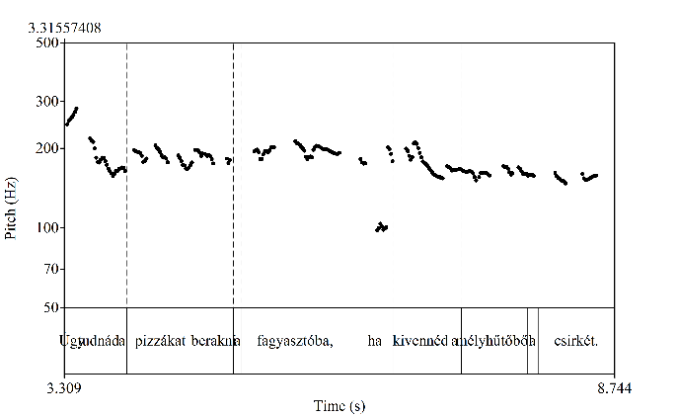
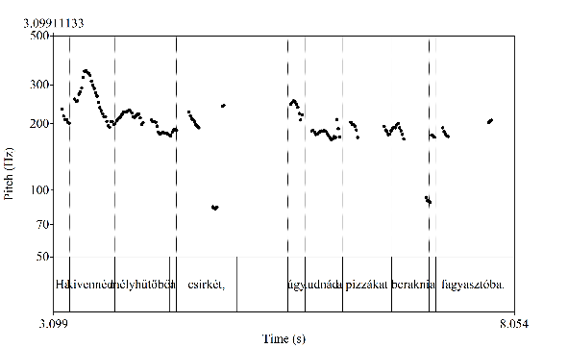
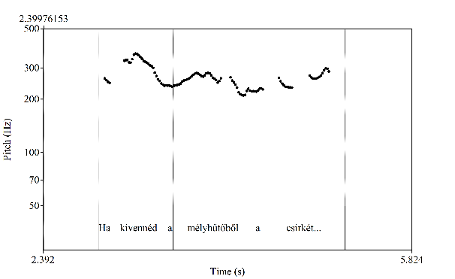
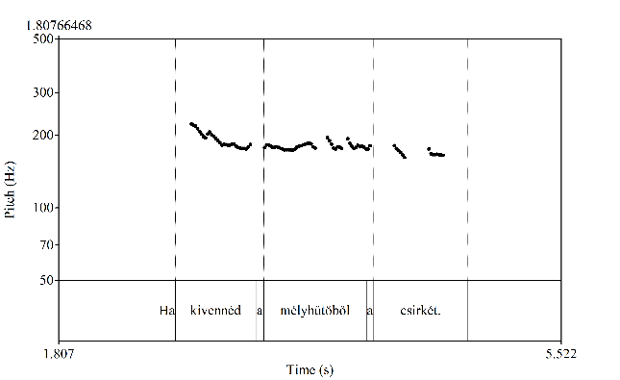
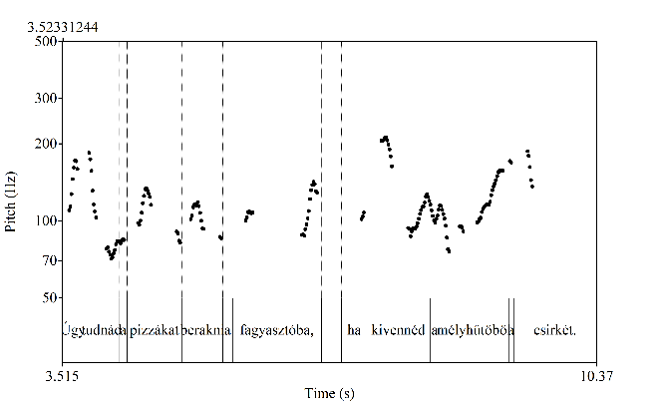
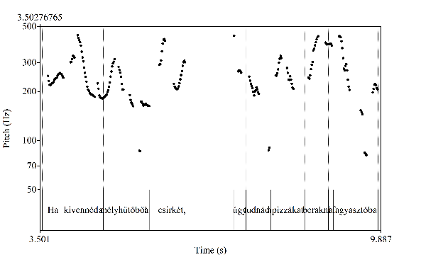
5. Ha kivennéd a mélyhűtőből a csirkét… [request] if take.out.cond.2sg the freezer.elat the chicken.acc
’If you could take the chicken out of the freezer…’
The prosodic pattern of the insubordinate clauses suggest incompleteness (final rise).
SUBORDINATE, WITHOUT MAIN CLAUSE,
NON-DIRECTIVE
SUBORDINATE, WITH MAIN CLAUSE, NON-DIRECTIVE
INSUBORDINATE, DIRECTIVE
Notes:
In all cases of Ha kivennéd a mélyhűtőből a csirkét, the verb (kivennéd ‘take out’) bears the main stress. As in the previous sentence types, the elliptic subordinate version (5c) ends in a flat contour.
Among the subordinate realizations (5d, 5e), we find various solutions, again, with several stress patterns.
The insubordinate construct (5a) appears to be obligatorily closed by a rising tone which, again, invites the hearer to complete the sentence.

Slide 19
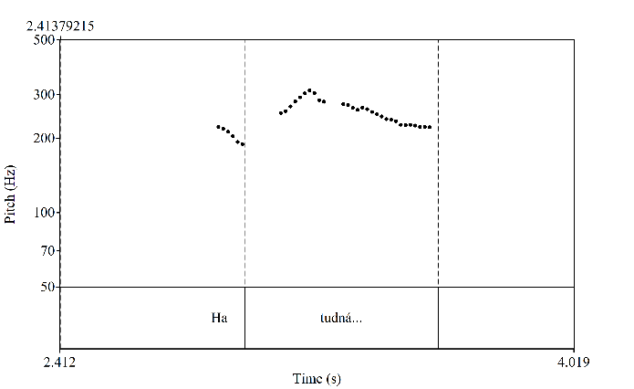
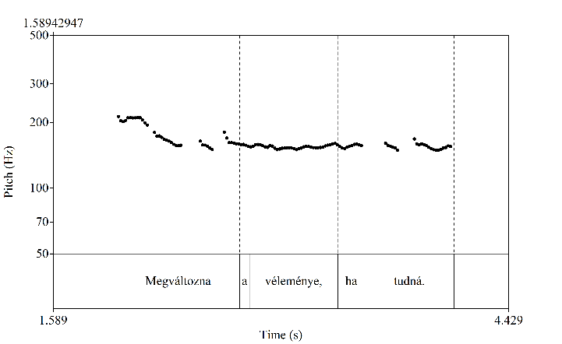
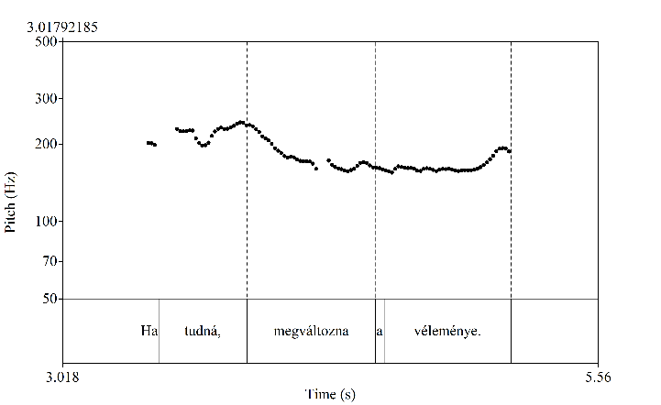
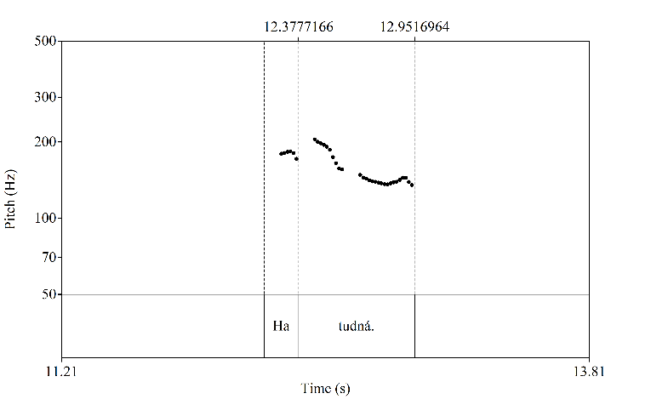
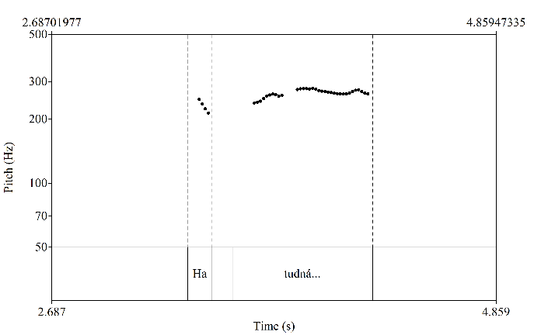
6. Ha tudná… [evaluation, worry, fear] if know.cond.tr.3sg
’if s/he only knew…’
The prosodic pattern of the insubordinate clauses might suggest incompleteness, but prosody is not a strong marker in this case.
SUBORDINATE, WITHOUT MAIN CLAUSE, NON-EVALUATIVE
SUBORDINATE, WITH MAIN CLAUSE, NON-EVALUATIVE
INSUBORDINATE, EVALUATIVE
No experimental data.
The most participants interpreted it as an insubordinate construct, the recorded samples are not conclusive.
EXPECTED
Notes:
During the analysis, we found that the prosodic implementation of the non-evaluative elliptic construct (6b) did not meet our expectations, as the participants produced the evaluative insubordinate variant for this sentence type. This suggests that the insubordinate version with the evaluative intention is predominating. Therefore, in the slide it can be observed in the production of the second author.
If we compare the prosodic patterns of the non-evaluative subordinate construct (6c, 6d) and that of the insubordinate evaluative one (6a), the latter one shows a less steep falling contour with a narrower pitch range. In the insubordinate construct (6a) high flat contours were also detected, however, final rise didn’t appear. We might suppose that the construct Ha tudná itself conveys the evaluative meaning without any prosodic support that might explain the uniformity of the experimental data.

Slide 20
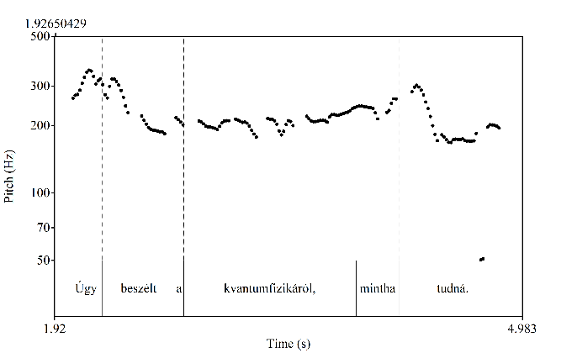
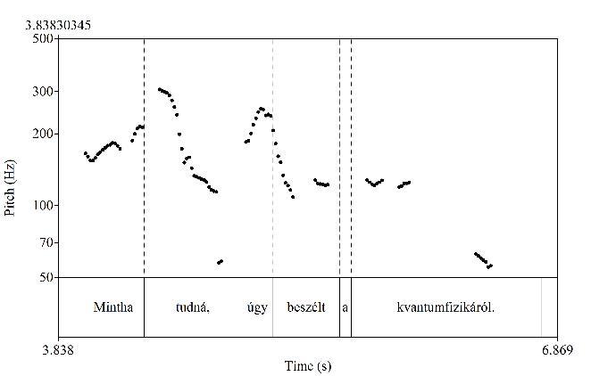
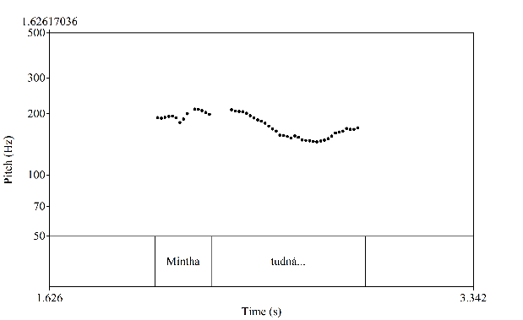
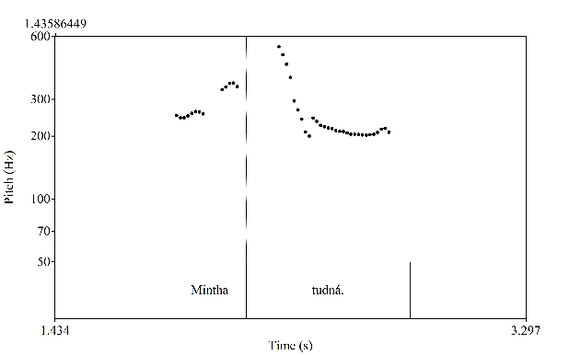
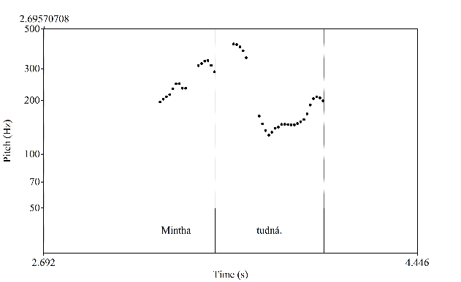
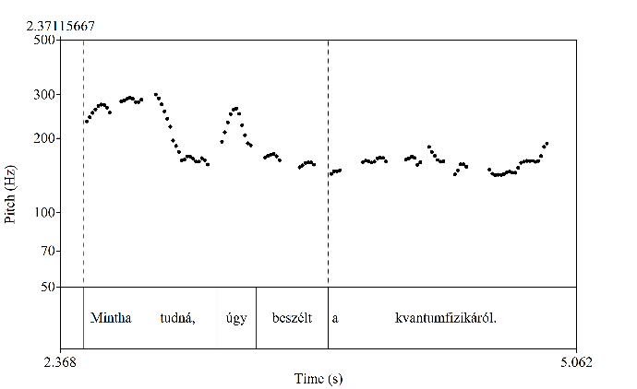
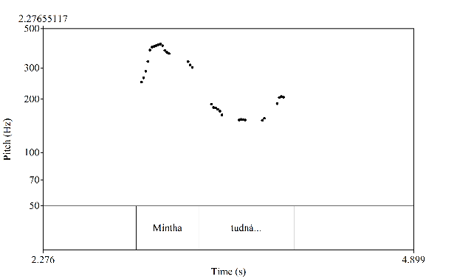
10. Mintha tudná… [assertive, sarcastic-sceptic] as.if know.cond.tr.3sg
’ As if s/he knew…’
The sentence-final rising tone and the high tone on the conjunction word might convey the additional meaning in the insubordinate constructs.
SUBORDINATE, WITHOUT MAIN CLAUSE, NON-SARCASTIC
SUBORDINATE, WITH MAIN CLAUSE, NON-SARCASTIC
INSUBORDINATE, SARCASTIC
Notes:
In the elliptic subordinate construct (10c) the high tone is localized on the stressed verb, and the intonation contour might end either with a rise or with a declination. The within-sentence subordinates (10d, 10e) show the same pattern, but also the conjunction word mintha might be high. In the insubordinate construct (10a) two prosodic patterns can be observed. One of them is similar to the rising ended subordinate patterns but with a narrower pitch range. The second one starts with a high tone on mintha.

Slide 21
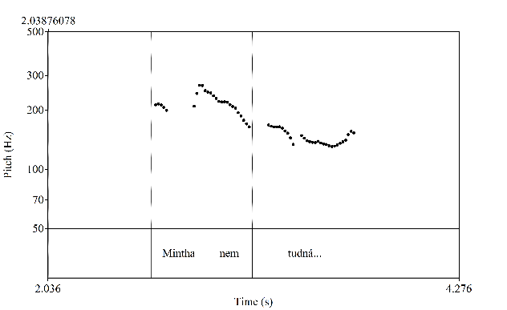




Assertive insubordinate clauses
INSUBORDINATE, ASSERTIVE–NEGATIVE
INSUBORDINATE, SARCASTIC
INSUBORDINATE, SARCASTIC
INSUBORDINATE, SARCASTIC
Notes:
We sought to identify similarities in the case of assertive insubordinate clauses, as this semantic/pragmatic type was the most represented in our dataset.
Ha ez nem rögeszme… ’’
Mintha nem tudná… ’’
Mintha tudná…. ’’
Mintha értenél hozzá ’’…
According to our results, all these insubordinate constructs present at least two versions: one with final rise and another one which shows an alternative stress pattern (stressed pronoun /ez/ or conjunction word, instead of the stressed negation word or verb).

Slide 22
Conclusions
Pragmatic meaning might be expressed by several prosodic patterns in INSUBORDINATION: final rise, resemblence of embedded subordinate construct, alternative stress patterns, smaller pitch range (with less steep declination/inclination/high-flat contour): ⇨ several variants
Most of them suggest INCOMPLETENESS
Final rise: all mintha-constructions + 4. Ha ez nem rögeszme…, 5. Ha kivennéd a mélyhűtőből a csirkét…
Resemblence of embedded subordinate construct:
1. Ha te mondod…, 2. Ha nekem ilyen telefonom lenne…, 3. Ha van felesleges pénzkidobás…, 6. Ha tudná…, 7. Mintha értenél hozzá…, 9. Mintha nem tudná…
Notes:
As the results show, additional pragmatic meaning might be conveyed by several prosodic patterns in insubordination. Final rise, similarly to several earlier international data, is rather frequent also in Hungarian. We found this pattern in all of the mintha-constructions and 4. Ha ez nem rögeszme…, 5. Ha kivennéd a mélyhűtőből a csirkét…
Sentence (5) is an exception in that, unlike the others, it is not of the assertive type but an expressive: a wish (optative > expressive).
In several cases, the intonational profile of insubordinate constructions resembles that of embedded (non-insubordinate) constructions with the same epistemic function (as we saw it in Czech): we found this kind of similarity in almost all sentence types.
Especially in mintha-constructions, one of the insubordinate prosodic patterns repeated the embedded (non-insubordinate) constructions’ alternative stress position (namely the stress on the conjunction word), but shifted stress was also observed in 1. Ha te mondod and 4. Ha ez nem rögeszme, too.
As opposed to Spanish data (Royo Viñuales (2023), we found smaller (not greater) pitch range in several insubordinate constructs (compared to the elliptic subordinate ones), and less steep declination. A few examples of slight rise and high-flat contour were also observed.

Slide 23
Conclusions
Alternative stress patterns: all mintha-constructions + 1. Ha te mondod…, 4. Ha ez nem rögeszme…
Smaller pitch range (with less steep declination/inclination/high-flat contour): 1. Ha te mondod…, 6. Ha tudná…, 7. Mintha értenél hozzá…, 8. Mintha válaszoltam volna…, 10. Mintha tudná…
Production experiment ⇨ variance due to different interpretations? ⇨ perception tests needed
Notes:
Insubordinate construct of almost each sentence type showed various patterns, in several cases with multiple prosodic means and different combinations.
Our analysis on the basis of a production experiment raises several questions, here we would like to address only two of them.
First, whether this kind of variability is due the various interpretations constructed by the participants, or natural speech would provide similar variety of prosodic patterns. As Hungarian speech databases are not sufficient (or not available) for the analysis of the present phenomena, this question remains open.
However, we could find the prototypical prosodic patterns via perception tests in the future.

Slide 24
Thank you for your attention.
?Hogy megköszönjem a figyelmet…
?Ha megköszönhetem a figyelmet…

Slide 25
References
Elvira-García, Wendy 2019. Two constructions, one syntactic form: Perceptual prosodic differences between elliptical and independent <si + V indicative> clauses in Spanish. In: Beijering, Karin, Kaltenböck, Gunther & Sansiñena, María Sol (eds.): Insubordination. Theoretical and empirical issues. Berlin–Boston: Mouton de Gruyter. 240–264.
Elvira-García, Wendy, Roseano, Paolo & Fernández-Planas, Ana Ma. 2017. Prosody as a cue for syntactic dependency. Evidence from dependent and independent clauses with subordinaton marks in Spanish. Journal of Pragmatics 109: 29–46.
Evans, Nicholas 2007. Insubordination and its uses. In: Nikolaeva, Irina (ed.): Finiteness. Theoretical and empirical foundations. Oxford: Oxford University Press. 366–431.
Fried, Mirjam & Machač, Pavel 2022. Intonation as a cue to epistemic stance in one type of insubordinate clauses. Folia Linguistica 56(1): 183–214.
D’Hertefelt, Sarah 2018: Insubordination in Germanic: A typology of complement and conditional constructions. Berlin – Boston: Mouton De Gruyter.
Kaltenböck, Gunther & Keizer, Evelien 2022. Insubordinate if-clauses in FDG: Degrees of independence. Open Linguistics 8: 675–698.
Lombardi Vallauri, Edoardo. 2016. Insubordinated conditionals in spoken and non-spoken Italian. In: Evans, Nicholas & Watanabe, Honore (eds.), Insubordination, 145–169. Amsterdam: John Benjamins.
Sánchez López, Cristina 2019. Optative and evaluative que ’that’ sentences in Spanish. In: Beijering, Karin, Kaltenböck, Gunther & Sansiñena, María Sol (eds.): Insubordination. Theoretical and empirical issues. Berlin–Boston: Mouton de Gruyter. 291 –319.

Slide 26




7. Mintha értenél hozzá… [assertive, sarcastic-sceptic] as.if know.about.cond.2sg it.all
’As if you knew what you were doing…’
The prosodic pattern of the insubordinate clauses might suggest incompleteness, but prosody is not a strong marker in this case.
SUBORDINATE, WITHOUT MAIN CLAUSE,
NON-SARCASTIC
SUBORDINATE, WITH MAIN CLAUSE, NON-SARCASTIC
INSUBORDINATE, SARCASTIC
Notes:
As in the previous sentence types, the neutral elliptical version (7c) of Mintha értenél hozzá ends in a flat contour. In the elliptical and most of the subordinate cases, the verb (értenél ‘know-about’) bears the main stress.
In one version of that subordinate construct which appears as the second clause of the complex sentence (7d), the high tone is realized on the conjunction word mintha ‘as.if’.
In the insubordinate construct (7a) we found two versions. One of them shows a stress on the verb, but as opposed to the elliptical construct the insubordinate construct elaborates a narrower pitch range and is closed by a rising tone. The other version stresses the conjunction word mintha ‘as.if’ which is similar to the second version of the subordinate where this construct appears as the second part of the complex sentence.

Slide 27






8. Mintha válaszoltam volna… [assertive, certainty] as.if answer.pst.1sg be.cond.3sg
Prosody does not differentiate strongly the elliptic subordinate and the insubordinate constructs.
SUBORDINATE, WITHOUT MAIN CLAUSE, UNCERTAIN
SUBORDINATE, WITH MAIN CLAUSE, UNCERTAIN
INSUBORDINATE, CERTAIN
Notes:
The SUBORDINATE, WITHOUT MAIN CLAUSE shows two patterns. We found here a prosodic pattern which appears in all construct: a high tone on the verb and afterwards a flat or rising closure. Another pattern detected in the elliptic subordinate construct (8b) shows another stress on the auxiliary. Variants of the previous prosodic pattern also appears both in the first and second clause subordinate and in the insubordinate. The latter one, however seems to be unique for this construct.
The second version of insubordinate shows a gradient declination from the verb which also seems to be unique (based on our data).
The basic prosodic patterns of elliptic subordinate and the insubordinate are largely similar, and this suggests that these two constructs are not differentiated by prosodic means.

Slide 28




9. Mintha nem tudná… [sarcastic-sceptic] as.if not know.cond.tr.3sg
’As if s/he didn’t know…’
The sentence-final rising tone or the high tone on the conjunction word might convey the additional meaning in the insubordinate constructs.
SUBORDINATE, WITHOUT MAIN CLAUSE,
NON-SARCASTIC
SUBORDINATE, WITH MAIN CLAUSE, NON-SARCASTIC
INSUBORDINATE, SARCASTIC
Notes:
In the case of Mintha nem tudná we also see several versions. The main stress is on the negation word in elliptic subordinate (9c) and within-sentence subordinate constructs (9d, 9e), or the conjunction word mintha ‘as.if’ can also be stressed within the complex sentence. These patterns are repeated in the insubordinate construct, as well as multiple stresses were documented. Here, the sentence-final rising tone or the high tone on the conjunction word might convey the meaning of sarcasm and invite the hearer to complete the sentence.

Slide 29
Semantic/pragmatic subtypes
D’Hertefelt (2108):
Deontic (including wishes): evaluate a potential state of affairs (SoA) in terms of desirability [others: declarative vs. non-declarative]
Evaluative/exclamative: evaluate an actual SoA in terms of expectedness
Assertive: assert or emphatically confirm that something is the case

Slide 30
Table 1.
 | INSUBORDINATE | ELLIPTIC | MAIN C.+ SUBO. C. | SUBO. C.+ MAIN C.
1 | High tone (main stress on mondod), falling end OR flat/rising | High tone (main stress on te) + flat end | flat | high tone (main stress on mondod) / flat
2 | various patterns | high-tone (main stress on ilyen) | high-tone (main stress on ilyen) | various patterns (stress on nekem/ilyen/telefonom/multiple words)
3 | high-tone (main stress on van) | high-tone (main stress on van) | declination+flat contour+rising end | high-tone (various)
4 | high-tone (main stress on nem) | high-tone (main stress on nem (or ez+nem)) | high-tone or flat | high-tone (various)
5 | high tone + rising end | declination + flat end | high-tone (various) | high-tone (various)

Slide 31
 | INSUBORDINATE | ELLIPTIC | MAIN C.+ SUBO. C. | SUBO. C.+ MAIN C.
6 | high-tone (with less steep falling contour) / flat | high-tone (with steeper falling contour) | flat | high-tone
7 | high-tone (main stress on értenél with narrower pitch range)+ rising end OR high tone (main stress on mintha) | high tone (main stress on értenél) | high tone (main stress on értenél) OR high tone (main stress on mintha) | high tone (main stress on értenél)
8 | high tone + rising end OR full declination | high tone + rising end OR multiple high tones | high tone + flat end | high tone + flat end
9 | high-tone (main stress on nem/nem+tudná with narrower pitch range)+ rising end OR high tone (main stress on mintha) | high tone (main stress on nem) + flat end | high tone + flat end | high tone +flat end
10 | high-tone (main stress on tudná with narrower pitch range)+ rising end OR high tone (main stress on mintha) | high tone + rise/declination | high tone + rise | high tone (main stress on mintha) + final declination

Slide 32
Table 2
with final rise (in at least one of the variants) | 4. Ha ez nem rögeszme… [assertive, ’I think the opposite of it’] if this not fixation
 | 5. Ha kivennéd a mélyhűtőből a csirkét… [request] if take.out.cond.2sg the freezer.elat the chicken.acc
 | 7. Mintha értenél hozzá… [sarcastic-sceptic] as.if know.about.cond.2sg it.all even: ’I dont’ think so’
 | 8. Mintha válaszoltam volna… [conviction, certainty] as.if answer.pst.1sg be.cond.3sg
 | 9. Mintha nem tudná… [sarcastic-sceptic, even: ’I’m sure about it’] as.if not know.cond.tr.3sg
 | 10. Mintha tudná… [sarcastic-sceptic, even: ’I dont’ think so’] as.if know.cond.tr.3sg
no final rise | 1. Ha te mondod… [sarcastic-sceptic, even: ’I don’t believe you’] if you say.2sg
 | 2. Ha nekem ilyen telefonom lenne… [wish] if me.dat such phone.Poss.1sg be.cond.3sg
 | 3. Ha van felesleges pénzkidobás… [assertive, strong declaration] if be.3sg pointless waste.of.money
 | 6. Ha tudná… - evaluation [worry, fear] if know.cond.tr.3sg

