Slide 1


Corpus-based analysis of independent conditional clauses and their semantic-pragmatic roles in Hungarian
Csilla Ilona DÉR (Károli Gáspár University, HUN-REN Hungarian Research Centre for Linguistics) &
Bálint SASS (Hungarian Research Centre for Linguistics)
INPRA 2024, Pisa, 31st May, 2024

Slide 2
Independent (insubordinate) clauses
„the independent use of constructions exhibiting prima facie characteristics of subordinate clauses” (Evans – Watanabe 2016: 2, cf. Evans 2007)
„insubordinate” clause (missing main clause) (Evans 2007)
3 basic functions:
  Modal: express speaker attitudes
  Interactional/interpersonal: manage speaker/hearer interactions
  Discursive: organize the discourse
  A) syntactically and pragmatically independent, own illocutionary force: stand-alone (performative) independent clauses
B) syntactically independent: elaborative (discourse-connective) independent clauses
(Sansiñena 2015, D’Hertefelt 2018, Kaltenböck 2016, 2019)
Notes:
In this presentation I am going to talk about independent, or in other words insubordinate clauses, the main character of which is that they are conventionalized as main clauses, and they contain a subordinate conjunction (complementizer), they have different pragmatic functions (discourse-connective, modal or interpersonal functions). There are 2 main types of them: stand-alone and elaborative independent clauses.

Slide 3
Independent conditional clauses
2 main types of independent clauses:
Complement insubordination: introduced by ’that’ (that, dass, que, etc.)
Conditional insubordination: introduced by conditional subordinators, ’if’ (if, wenn, als, etc.)
ha ‘if’ ~ hogyha ’if’, amennyiben ’if, in case’
Protasis: if X (subordinate clause) [+ apodosis: (then) Y (main clause)]
If you [do this], (then) this will happen.
Example (threat):
(1) MARA Te meg jobban teszed, ha meghúzod magad, és egy szót sem szólsz, érted?! Ha még egyszer meglátlak Béni közelében!
’MARA You'd do better if you shut up and don't say a word, understand?! If I see you near Béni again!’ (MNSz2, #90948270, literature)
Notes:
Independent clauses have already been found in many languages of the world, they have two main types in terms of semantic-syntactic relations: they can have subordinate marking, in this case we are talking about complement insubordinaton, or they can bear conditional marking, then we are dealing with conditional insubordination. In Hungarian the latter can appear with several conditional conjunctions, but in the present presentation we will focus on the ones starting with HA.
The usual structure of conditional sentences is as follows: the protasis typically precedes the apodosis. The apodosis explains the consequence of the fulfillment or non-fulfillment of the condition described in the protasis.
In the case of conditional insubordinate clauses, the apodosis disappeared over time or their dependency shifted, this means – I’m using the words of D’Hertefelt (2018: 160-161) – „subordinating conjunctions shift away from under the scope of their main clause”.
Let’s see an example of stand-alone independent conditional clauses, a threat: (1)

Slide 4
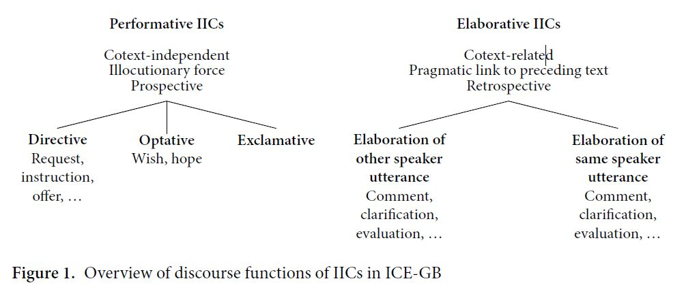
Typologies of independent conditional clauses
All of them are corpus-based
Kaltenböck (2016: 349): for British English
Notes:
I will now very briefly review three typologies describing independent clauses of different Indo-European languages. All of them are corpus-based.
Kaltenböck (2016) distinguishes two types of insubordinate independent clauses in British English: performative IICs and elaborative IICs, the former are both syntactically and pragmatically independent, the latter are only syntactically free. The author also differentiates between directive, optative and exclamative subtypes in the first group, and between two types of elaboration in the second one.

Slide 5
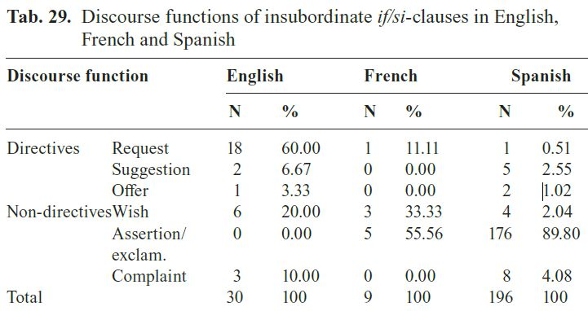
Typologies of independent conditional clauses
Lastres-López (2018): British English (BNC)
Lastres-López (2020): English (British Parliament Hansard Corpus), French (French/English Hansard Corpus from the Canadian Parliament), Spanish (Diario de Sesiones del Congreso de los Diputados)
only stand-alone independent clauses (linked to speech acts):
directive: request, suggestion, offer, threat, permission
non-directive: wish, assertions/exclamations, complaints
„While 70% (21 tokens) of the total number of insubordinate clauses serve directive functions in English, the proportion of directives reduces drastically in the two Romance languages, where directives only account for 11.11% of the cases (1 token) in French and 4.08% of the cases (8 tokens) in Spanish.” (Lastres-López 2020: 133)
Notes:
Lastres-López (2020) analyzed insubordinate clauses in parliamentary texts in 3 languages (British English, Canadian French, Spanish), and she identified 2 types (she considered only the stand-alone cases to be independent clauses): directive and non-directive clauses. She also mentions that there is a huge difference between the two Romance languages and English in terms of directives: request, suggestions and offers are much more common in the latter one.

Slide 6
Typologies of independent conditional clauses
D’Hertefelt (2018): 6 Germanic languages (English, German, Dutch, Swedish, Danish, Icelandic), constructional typology, 2 criteria: conventionalized main clause usage, formal subordinate marking
1. deontic (wish, request, suggestion, threat): a potential state of affairs (SoA) is evaluated by the speaker in terms of desirability
2. evaluative: evaluate a particular SoA as remarkable, negative or absurd (If you’d know!)
3. assertive: assert that sg is the case (If that’s not X…)
4. argumentative: justify (the speaker’s implied attitude to) something which was said in the preceding discourse (If at least it had been an X…)
5. reasoning: „form the starting point for an invited line of reasoning” (p. 136) (And if he does come?)
+Post-modifying conditional constructions: specify extra condition for something that was said before:
(2) A: There was two dolls, a boy and a girl doll and the boy was actually (pause) like a boy.
B: Yeah?
A: If you know what I mean. (Heine, Kuteva & Kaltenbock 2016: 56, cited by D’Hertefelt 2018: 178)
Notes:
One of the most comprehensive typologies comes from D’Hertefelt (2018), who categorized independent clauses in 6 Germanic languages. We can see her semantic categories of conditional independent clauses on this slide: 6 different types: deontic, evaluative, assertive, argumentative, reasoning and post-modifying. The last three are only syntactically independent, so they correspond to the elaborative type of complement insubordinate clauses.

Slide 7
Our preliminary typology
Stand-alone:
deontic
exclamative/evaluative
assertive
others?
Elaborative:
metalinguistic: make comments or to provide explanations on the content of certain stretches of discourse” (Lastres-López 2020: 75), e.g. if you like/choose/want (Brinton 2014)
argumentative (based on Lastres-López 2018)
reasoning (based on Lastres-López 2018)
others?
(Dér 2023a, b; Dér – Sass 2024)
Notes:
Based on our earlier research on Hungarian complement and conditional independent clauses, we worked with the following categories shown on the slide.
The metalinguistic type has already been dealt with by several linguists, these are primarily comments on language use, stylistics, etc.

Slide 8
Aims
1. To collect as many conditional independent clauses from the as possible the Hungarian Gigaword Corpus (MNSz2) using automatic methods (specially crafted CQL queries)
Problems:
they’re much rarer compared to regular conditional clauses with a main clause
same form as other subordinate conditional clauses
the corpus is not annotated pragmatically
2. to classify the valid hits into semantic-pragmatic categories (using the typologies of D'Hertefelt 2018, Kaltenböck 2016 and Lastres-López 2018)
3. To describe typical formal features (e.g. particles, set phrases)
4. To describe changes in these categories/features along the length of the clauses (word number)

Slide 9
Assumptions
The most successful extraction criteria will be the following (cf. Dér & Sass 2024: independent complement clauses in Hungarian, 32,3%):
  start with the conjunction Ha ’if’ with an uppercase letter;
  have (typical) closing punctuation (e.g. exclamation mark)
  short sentence length (2–7 words after Ha + closing punctuation)

Slide 10
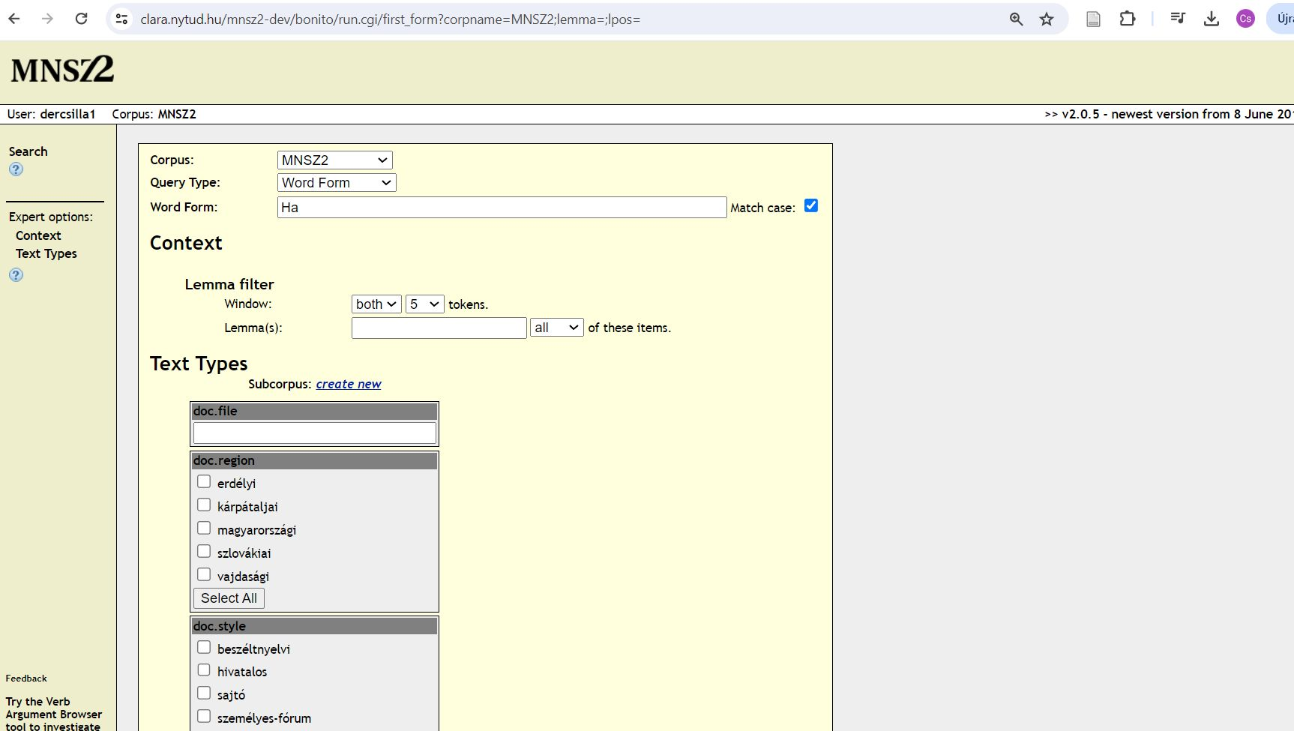
Data, method
Hungarian Gigaword Corpus (Magyar Nemzeti Szövegtár 2 = MNSz2)
1.5 billion words
specially crafted CQL queries
random 500-hit lists
filtering out duplicates
expert annotator
manual annotation
Notes:
Our corpus was the MNSz, which consists of 1.5 billion words.
Simple searches did not result in a large number of hits, since independent clauses make up approx. 4-5% of the hits in random samples (when the we are looking for typical conjunctions, like HA ’if’), so we had to resort to another solution: we used specially crafted CQL. We analyzed random 500-hit lists, filtered out duplicated cases. One expert annotator (the first author) using manual annotation categorized the valid hits.

Slide 11
CQL query
<s> [word="Ha"] [word!="[?!.,;]+"]{LENGTH} [word="[?!.,;]+"]+ </s>
beginning of sentence + "Ha" + LENGTH pieces of non-punctuation word
s + punctuation word + end of sentence
LENGTH = 2 .. 7
columns of data table:
* LENGTH
* word id
* filename
* left context
* hit
* right context
explicit LENGTH column:
* allows sorting the data by length
* helps investigating the data by length

Slide 12
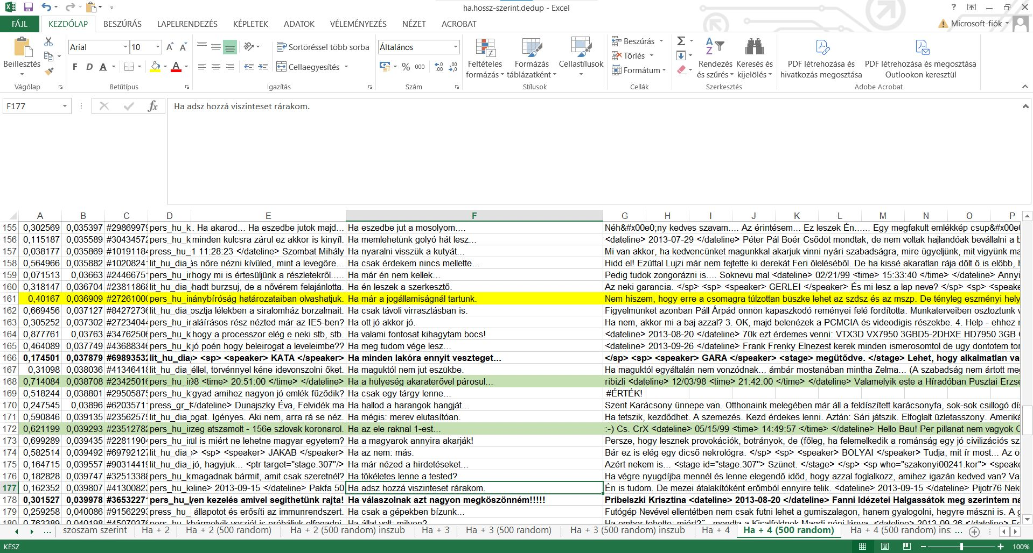
Data, method
Notes:
We used Excel sheets to find the valid insubordinate clauses. A relatively large (several sentences) context is needed to find these sentences

Slide 13
Results
 | all hits | independent clauses (random sample, N = 500) | stand-alone clauses | elaborative clauses
Ha + 2 words + pm | 3884 | 66 | 36 | 30
Ha + 3 words + pm | 4785 | 71 | 52 | 19
Ha + 4 words + pm | 8726 | 34 | 22 | 12
Ha + 5 words + pm | 5169 | 43 | 33 | 10
Ha + 6 words + pm | 5333 | 24 | 17 | 7
Ha + 7 words + pm | 4439 | 21 | 14 | 7
Total | 32336 | 259 | 174 | 85
Notes:
Although the 4-word results stood out in terms of quantity, as they contained many duplicates, only a few valid results remained.
We found twice as many stand-alone sentences as elaborative clauses, they were mostly 2-3-4-5 word clauses. A total of 259 valid hits out of 3000 clauses (6 times 500-hits) were independent, that is 8.6% of the 3000 random hits (6x500).

Slide 14
Notes:
Looking at all correct hits, two-thirds of the sentences were stand-alone, the biggest difference between the two subtypes (stand-alone, elaborative) was in the case of the 5-word clauses (more than three-quarters of them were stand-alone), and the smallest difference in the 2-word ones (almost half of them was stand-alone).

Slide 15
Examples
2 words: stand-alone, wish
(3) – Északon már most sincs így. – Éppen ez az – csapott le rá az őrnagy. – Hogyan van Északon? Ha ezt tudnám! (MNSz2, #57624624, literature)
’"It's not like that in the north anymore." "That's it," snapped the major. "How is it in the North? If only I knew that!”’
3 words: elaborative, metalinguistic
(4) Nem volt gyerekünk. Ő volt a gyerekem. Ha így lehet mondani. (MNSz2, #1241769345, spoken)
’We had no children. He was my child. If you can call it that.’
4 words: stand-alone, deontic, wish
(5) Ó, ha mindent így el tudna intézni! Ha Anya maradhatna az Intézetben! (MNSz2, #89517885, literature)
’ Oh, if only he could manage everything like this! If Mother could stay at the Institute!’

Slide 16
Examples
5 words: stand-alone, deontic, request
(6) Nem éppen depressziós... de hát kissé borús kedély. És ugye egy ilyen gyászfátyol, ahogy lelóg az asztalról... Ha esetleg melléje festene valami vidámabbat. (MNSz2, #56190698, literature)
’ He's not exactly depressed... but he's in a slightly gloomy mood. And, isn't it, such a mourning veil as it hangs from the table... If you could paint something more cheerful next to it.’
6 words: elaborative, argumentative
(7) Viadal nem volt, csak az én égő pofájú elkullogásom. Ezenkívül harc soha föl se merült. Ha legalább becsületes nőért küzdések lettek volna! (MNSz2, #105721537, literature)
’ There was no fight, just my scalding face. Also, a fight never arose. If only there had been fights for an honest woman!’
7 words: elaborative, metalinguistic
(8) Az összefogás fontos, csodákra képes. Ha még mindig nem lenne elegünk a frázisokból. (MNSz2, #340135112, personal-socialmedia)
’ Teamwork is important, it can do wonders. If we still haven't had enough of the phrases.’

Slide 17
Notes:
As for the individual small categories, looking at all the results, more than a third of them are deontic, more than a quarter of them are meta-linguistic and a quarter of them are exclamative, these are the three prominent categories, the rest are below 10%. We saw a spectacular difference between them in the case of the 5-word clauses: almost two-thirds of them are deontic, and one-quarter are meta-linguistic. The case of 2-word phrases is also interesting: almost 40% of the results are meta-linguistic, but only one-fifth are deontic. The number of words therefore significantly affects the distribution of individual small types, there can be differences of up to 25%. This large fluctuation in terms of word number is equally true for all three standout categories (at least 19% differences exist, but it reaches 40% in deontic category).

Slide 18
Notes:
On this slide, we can see the proportion of each semantic type in sentences of different lengths.
In the case of the quantitatively most outstanding three categories (deontic, evaluative/exclamation, meta-linguistic), different ratios are visible: deontic mainly stands out from the line, it consists of 5 or 7 words the most, evaluative has 2-3-4 words, and meta-linguistic has 2 words.

Slide 19
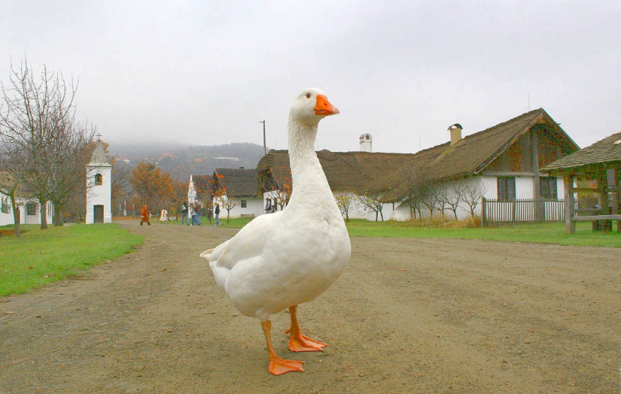
Formal features
DEONTIC: wishes (ha takes the place of the optative particle + legalább + conditional verb form), requests (conditional verb form)
EVALUATIVE: conditional or indicative verb form
ASSERTIVE: 2–3 words after Ha (Ha van NP ’if there’s’)
OTHER: set phrases, proverbs (Ha már lúd… [legyen kövér] ’If it is a goose, it should be a fat one.’ ['Somebody having an unexpected opportunity, makes the best possible use of it.'], Ha hallgattál volna… [bölcs maradtál volna] ’Silence is golden [lit. if you had remained silent, you would have continued to be a philosopher]’)
But: set phrases appear in every type: Ha tudná! ’If he knew!’ Ha mond ez valamit. ’I that says anything’ Ha érted, miről beszélek. ’If you know what I mean’ Ha lehet így mondani. ’If you can say so’ Ha jól értem. ’If I understand correctly’
(Source: https://kaposvarmost.hu/hirek/kaposvari-hirek/2019/11/11/marton-lud-mellye-ha-vilagos-ho-leszen-ha-fekete-eso-masolat.html)
Notes:
The conditional verb form is common in three types: wish, request (directives) and exclamatives, e.g. ha tudnád ’i you’d knew’ can appear in all of them, depending on the context and intonation.
It helps to identify the wishes if we replace "ha" with an optative particle (bár ’if only, I wish’). Sometimes we find proverbs in independent form, their function is similar to evaluations. Set phrases are very common, especially among wishes and metalinguistic independent clauses.

Slide 20
Formal features
METALINGUISTIC: Ha már [topic/main character] ’speaking of’… and/or: verbs and other expressions of speaking (szóba került, szó van vmiről, vminek nevezni/mondani, beszél, tart)
(9) Azt hiszem ez a vita már nagyon elkanyarodott az eredeti témától, hisz vallási témájú lett... Ha már vallás… Inkább hiszek a táltosoknak mint a keresztény papoknak! (MNSz2, #348578653, personal-socialmedia)
’ I think this discussion has gone way off the original topic, as it has become a religious one... Speaking of religion... I’d rather believe in the táltos than Christian priests!’
REASONING: conditional verbform (or elliptic); and before ha
(10) Senki sem tudja, milyen beteg vagyok. Ha elmennék orvoshoz… (MNSz2, #3087514, literature)
’ Nobody knows how sick I am. If I went to a doctor...’
(11) Mert tisztázni kell a legénnyel, ő nem tűri tovább, házasodjanak össze, de hát a legény lapít, miért lapítanak a legények, és nem csókolja szájon, ráteszi közben a tenyerét az arcára. Ha mégis a húgát…?! (MNSz2, #40623061, literature)
’ Because he has to come clean with the lad, he won't tolerate it any longer, they should get married, but the lad is flat, why do boys flat, and he doesn't kiss her on the lips, he puts his palm on her cheek. If it's her sister...?! ’
ARGUMENTATIVE: [Ha + legalább ’if at least’] (7)
Notes:
The particle már ’yet, already’ following the conjunction ha is typical in meta-linguistic clauses in the role of referring to the (new) topic of the discourse. The reasoning type is also often formally similar to other categories due to the conditional verb form and ellipsis, while the argumentative type is reminiscent of the evaluative type, e.g. the legalább ’at least’ element can appear in both.

Slide 21
Formal features
But: same collocation, but different types
Ha + MÁR ’if already’: metalinguistic, formulaic (goose-example), argumentative
(12) A pénz tehát több helyütt elfogyott, a bizalom viszont még nem. Pillanatnyilag talán ez így szerencsés, de ideális esetben a két fogalom kéz a kézben jár. Ha már egyszer üzleti alapú futballgazdaságot építünk. (MNSz2, #810219328, press)
’ So in many places the money is gone, but the trust is not yet gone. At the moment, this may be fortunate, but ideally the two concepts go hand in hand. If we are going to build a business-based football economy.’
Ha + EGYSZER ’if once’: assertive, deontic (threat, wish, request), argumentative
(13) GUNDI „Bájos” fintorral Nem szeretjük, ha nincs kifogás: nem igazándi a boldogság a Babaházban, nem hiteles és nem is lehet teljes, ha semmi hiba. ZSÓKA Ha egyszer nincs! (MNSz2, #29992116, literature)
’GUNDI with a "charming" wink We don't like no excuses: no real happiness in the Dollhouse, no authenticity and no way to be complete without any flaws. ZSÓKA Once there is none!’
(14) Sokat vitatkozunk hasonló témákon, de mindkettőnk tiszteletben tartja a másik álláspontját. Ha ez egyszer pl a politikusokkal is megtörténne... (MNSz, #317713220 , personal-socialmedia)
’We argue a lot about similar issues, but we both respect each other's views. If only this could happen with politicians...’
Notes:
As we have already seen in the previous slides, some collocations and formal solutions can appear in several semantic types:

Slide 22
Conclusion, summary
Stand-alone vs. elaborative: 2:1 (cf. complement insubordination, Dér & Sass 2024)
Deontic type: non-directives (wish/hope): 46% vs. directives (mostly requests): 54%
Stand-alone, all types: non-directives: 70,66% vs. directives: 29,34%
Assertive: only 2-3 word-clauses (after ha)
Deontic > metalinguistic > evaluative (above 26%), except deontic, their quantity gradually decreases as the number of words increases
Metalinguistic independent clauses are typically 2-word phrases (ha már N ’if already’), deontics are 5- or 7-word expressions: no clear formal pattern (many forms of wishes and directives)
Notes:
To sum up: it seems that in the case of Hungarian conditional independent clauses, the stand-alone type is more decisive, which is the opposite of what we found earlier in the case of complement insubordination (Dér&Sass 2024). The proportion of directives is not so low, they are mainly used in requests. The assertive type is the shortest in terms of the number of words when examined in general, but we also found variants with very few words in the case of other common types (e.g. meta-linguistic).
The deontic type is the most common, and it is the one whose number is hardly affected by the number of words, in the case of meta-linguistic and evaluative, their quantity decreases as we examine cases with more and more words. On average, deontics consist of 5-6-7 words (not counting the conjunction), but they are very diverse in form, and it is less possible to organize them into typical formal categories.

Slide 23
Thank you for your attention!

Slide 24


Acknowledgement
This research was supported by the János Bolyai Research Grant (BO/00191/21)
and by the ÚNKP-22-5-KRE-1 New National Excellence Program of the Ministry for Culture and Innovation from the sourse of the National Research, Development and Innovation Fund.

Slide 25
References
Brinton, Lauren J. 2014b. If you choose/like/prefer/want/wish: The origin of metalinguistic and politeness functions. In Marianne Hundt (ed.) Late Modern English Syntax. Cambridge: University Press. 270–290.
D’Hertefelt, S. (2018). Insubordination in Germanic: A typology of complements and conditional constructions. Berlin: De Gruyter.
Evans, N. (2007). Insubordination and its uses In Nikolaeva, Irina (Ed.) Finiteness. Theoretical and empirical foundations (pp. 366–431). Oxford: Oxford University Press.
Kaltenböck, G. (2016). On the grammatical status of insubordinate if-clauses. In: Kaltenböck, Gunther, Keizer, Evelien, Lohmann, Arne (Eds.) Outside the clause. Form and function of extra-clausal constituents (pp. 341–378). John Benjamins, Amsterdam & Philadelphia.
Lastres-López, C. (2018). If-insubordination in spoken British English: Syntactic and pragmatic properties. Language Sciences, 66, 42–59.
Lastres-López, C. (2020). KÖNYVE
MNSz2 = Magyar Nemzeti Szövegtár 2. változat [Hungarian Gigaword Corpus 2.0.5; 1.5 billion words]. http://clara.nytud.hu/mnsz2-dev/

Slide 26
All valid hits
HITS | 2 WORDS | 3 WORDS | 4 WORDS | 5 WORDS | 6 WORDS | 7 WORDS | TOTAL
DEO | 13 | 23 | 10 | 26 | 9 | 12 | 93
EXC | 19 | 19 | 11 | 7 | 4 | 2 | 62
ASS | 2 | 1 | 0 | 0 | 0 | 0 | 3
OTH | 2 | 7 | 0 | 0 | 1 | 0 | 10
META | 26 | 15 | 10 | 10 | 5 | 6 | 72
REAS | 4 | 5 | 3 | 0 | 1 | 0 | 13
ARG | 0 | 1 | 0 | 0 | 4 | 1 | 6
TOTAL | 66 | 71 | 34 | 43 | 24 | 21 | 259

