Slide 1
PHONETIC AND PRAGMATIC ANALYSIS OF THE DISCOURSE MARKER SZERINTEM ‘I THINK, TO MY MIND’ IN SPONTANEOUS CONVERSATIONS
6th International Conference on Conversation Analysis 2023
The University of Queensland
Australia, Brisbane
Dér, Csilla Ilona¹ – Huszár, Anna² – Horváth, Viktória² – Krepsz, Valéria^{2,3}
¹ Károli Gáspár University of the Reformed Church
² Hungarian Research Centre for Linguistics
³ Humboldt-Universität zu Berlin
Notes:
Welcome everyone and thank you for being here today.
The focal point of this presentation will be the analysis of the szerintem (which can be translated to I think or to my mind in English) discourse marker in 3-party conversations in younger and older adults’ utterances using qualitative and quantitative methodology in parallel.

Slide 2
INTRODUCTION
szerintem (~‘I think; to my mind’, cf. Aijmer 1997, Mullan 2010)
the most frequent opinion-marking discourse markers (DJs) in Hungarian (Dér 2016, 2020)
expresses evidentiality: epistemic-inferential (epistential) item (Kugler 2015), evaluation (Dér 2018)
data from the 19th century in Hungarian (Dér 2016)
inflected form of a noun: szer-int-em
szer ’mode, way’+ -ént (lative suffix -é + locative -n + locative -t) > szerint + personal suffix (-m, -d, -e, etc.)
different from the postposition szerint ’according to, pursuantly’ (from the 14th cent.), the root of szerintem
Notes:
Szerintem is the most frequent opinion-marking DM in Hungarian, but it also expresses evaluation and evidentiality: it is an existential (epistemic-inferential) item that signals that the speakers consider the truth of their statement to be probable (based on her/his own inferences/conclusions). We have data of szerintem from the 19th century but the postposion (szerint) from which it was formed appeared in Hungarian 400 years earlier. Szerintem was already present as a full-fledged DM when it first appeared.

Slide 3
INTRODUCTION
may signal a boundary in discourse (topic shift, summing, turn completion, etc.) (cf. DM-functions: Crible 2018)
boosting/mitigating/hedge function, depending on the topic of the conversation and the relationship of the interlocutors (Koczogh 2012, Dér 2020):
(1) M02: Az eutanázia bűn. F02: Szerintem ez nem bűn.
’M02: Eutanasia is a sin. F02: I don’t think it’s a sin’ (Koczogh 2012: 178)
(2) F05: Az eutanázia bűn. M05: SZERINTEM ez HÜLYESÉG.
’ F05: Eutanasia is a sin. M05: I THINK it’s NONSENSE’ (Koczogh 2012: 76)
in spontaneous conversations: LP (left periphery): 63%, medial: 23%, RP (right periphery): 14% (30 conv., 180 hits, Dér 2018)
Notes:
Besides its many rhetorical roles szerintem can also act as a sequential marker: it opens or closes a new boundary of a segment, the speakers can start or close a turn with szerintem, or mark a topic shift with it.
Interestingly, it can have both a mitigating (1) and a boosting role (2) in conversations, depending on the topic and the relationship of the interlocutors. For example if the speaker wants to politely express disagreement, he/she may use szerintem.
But in the case of szerintem, there is a distinction between increasing/decreasing the degree of politeness and softening/strengthening disagreement: we can strengthen the degree of disagreement while appearing polite.
A previous study (Dér 2018) showed that in spontaneous conversations szerintem preferred the left periphery (two-thirds of the cases), it appeared in medial position in a quarter of the occurrences and it took the right periphery in only 14% of the cases.

Slide 4
INTRODUCTION: szerintem & turn-taking
In absolute LP and RP position (when it is not preceded/followed by other markers or interjections) the speakers can take (3) and pass the floor (4) with szerintem:
(3) S: izguljanak a hollandok nem↑ nem↑ ()
Fw2: szerintem azoknak már végük↓
[S: Get the dutch excited, right?
Fw2: I think they are over’]
(4) S: úgyhogy majd megyünk vasárnap délben szerintem↓
Fw2: de ez csak két napos vagy van pénteken is↑
[A: so we will go on Sunday at noon I think
Fw2: but it’s only two days long or is it on Friday as well’]
Notes:
felolvasni

Slide 5
AIMS AND HYPOTHESES
We planned to conduct
a corpus-based analysis of szerintem from phonetic and pragmatic approach:
To analyze
the effect of age and gender of the speaker on the occurrence of the szerintem,
prosodic independence of szerintem (duration, F0 patterns) regarding its position
the occurrence of szerintem in turn-takings.
Hypotheses
Szerintem is phonetically independent (surrounded by pauses, ‘single word’) [Lam 2009, Gonen et al. 2015, Heine et al. 2021, but cf. Brinton 2017].
Szerintem occurs in initial pragmatic position (LP) in general (Dér 2018).
Szerintem occurs in the vicinity of turn takings, mainly in absolute turn-initial position after turn taking.
The occurrence and the realization of szerintem is influenced by the speakers’ age and gender.
Notes:
Our main aim is to give a corpus-based phonetic analysis of szerintem to determine whether age and gender have an effect on the occurence of this discourse marker (differences in duration, F0-patterns). We analyzed whether prosodic independence is true in the case of szerintem. We will also look at how szerintem appears/occurs in turn-takings.
Our hypotheses are as follows:
Szerintem is phonetically independent (surrounded by pauses, ‘single word’)
Szerintem occurs in initial pragmatic position (LP) in general.
Szerintem occurs in the vicinity of turn takings, mainly in absolute turn-initial position after turn taking.
The occurrence and the realization of szerintem is influenced by the speaker’ s age and gender as well.

Slide 6
METHODOLOGY
40 conversations were selected from the Hungarian Spontaneous Speech Database (BEA, Neuberger et al. 2014)
2 fieldworkers + 1 subject
2 age groups of the subjects (20–30 yrs, 40–55 yrs), 10 female, 10 male in each age groups
12 hours long material (average time: 18 min)
Word and interpausal unit (IPU) level annotation (just concerning to the target words szerintem ‘in my opinion’), extended with the information about the phonetic and pragmatic positions (Praat: Boersma–Weenink 2021)
Duration and f0 were extracted automatically using a Praat script
Extracting f0: different settings in each groups
Statistics: χ²-test Kruskal–Wallis-test, Mann–Whitney-test
Notes:
40 conversations were selected for the present study from the Hungarian Spontaneous Speech Database.
The subjects are all monolingual adults from Budapest, no one of them reported any hearing disorders. The protocol of the conversational part is the following. The conversation part is the sixth subtask of the recording. The fieldworker1 (Fw1) and the subject (S) participated in the previous parts, then the fieldworker2 (a colleague of the Fw1) joined the others. The three-participated conversations are quasi-spontaneous in the sense of the speech planning: the topic of conversation had been added at the beginning of the recording without any pre-fixed protocol or script to be followed. The participants had no time to plan the speech production, and the outcome depended on the opinion and utterances of others. Topics are selected by the fieldworker1 in accordance with the subject’s age, job, and area of interest (based on the previous narrative parts of the recordings), e.g. New Year’s Eve, wedding experiences, job hunt, Easter and Christmas holiday, school violence, etc. LEHET BELŐLE HÚZNI NYUGODTAN
The existing six-tier annotation (IPU (inter-pausal units) + pauses, word level for 3 speakers) was complemented with further tiers using the Praat software (Boersma and Weenink 2018): backchannel responses; overlapping speech; turn-takings
Two fieldworker had a conversation with each subjects – that’s why only subjects’ speech were analyzed (to avoid the overrepresentation of the two fieldworkers). Duration and f0 were extracted automatically using a Praat script, using different settings for F0 in each group (individual settings – if it is needed).

Slide 7
METHODOLOGY
Pragmatic positions: LP, RP, medial
absolute initial: szerintem is the first element in the clause (or turn)
initial: szerintem follows one or two (three) DM: hát szerintem ‘well I think’, hát de szerintem ‘well but I think’
medial: szerintem occurs in the clause structure
final: szerintem is the closing element after the clause
Positions regarding turn taking
absolute initial: szerintem is the first element in the IPU immediately after a turn taking
initial: szerintem is one element of the first IPU immediately after a turn taking
final: szerintem is one element of the last IPU before a turn taking
absolute final: szerintem is the last element of the last IPU before a turn taking
Notes:
Here you can see the positions and their definition we used in the analysis. felolvasni

Slide 8
Analysis of the position
Turn-taking
Turn-taking
abs. turn-initial
turn-medial
abs. turn-final
Speaker 1
IPU
SIL
IPU
SIL
SIL
Speaker 2
IPU
IPU
IPU
turn-initial
turn-final
Notes:
The next slide shows the positions of the szerintem words regarding the turn-takings.
so absolute turn-initial position means that the given szerintem occurred right after the turn-taking, in the absolute-final position the same was given for the final position
in the case of the turn-initial position: the szerintem appeared in the first interpausal unit of the turn, and the same was used for the final positions.
turn-medial occurrence were defined as a position between the two turn-takings.

Slide 9
ANALYSIS
The relation of szerintem and turn taking: occurrence, position (turn-final or turn-initial).
Timing patterns of turn taking, Floor Transfer Offset (FTO): time between the end of the current speaker’s turn and the start of the following turn by the next speaker, De Ruiter et al. 2006, Stivers et al. 2009)
turn taking after a pause – positive FTO
turn taking with 0 ms FTO
turn taking after overlapping speech – negative FTO
The occurrence and realization (duration, F0) of szerintem regarding i) the position
(phonetic and pragmatic), ii) age,
iii) gender of the speaker
Notes:
Furthermore, we analyzed the relation of szerintem and turn taking regarding the occurrence and the position (whether szerintem occurred rather in turn-final or in turn-initial position). We also examined the timing patterns of turn taking, if there was a szerintem in the near vicinity preceding or following the turn taking.
The FTO (Floor Transfer Offset) is defined as the time between the end of the previous turn and the start of the following turn. The value is positive when a gap exists between the two turns, the FTO is zero, when the turn-taking happens without a gap, and the FTO is negative in the case of overlapping speech.

Slide 10
Notes:
And now, let’s see the results…

Slide 11
RESULTS
40 three-party conversations: szerintem occurred in 32 conversations (80%).
Occurrence: 5.5 ‘szerintem’/conversation (SD: 7.1 items/conv).
Min. occurrence: 1 ‘szerintem’/conversation
Max. occurrence: 39 ‘szerintem’/conversation
Distribution of szerintem regarding age and gender of the speaker
 | Female speakers | Male speakers | All
20–30 year olds | 56 | 72 | 128
45–55 year olds | 24 | 25 | 49
All | 80 | 97 | 177
Notes:
The szerintem occurred in the 80 percent of the recordings, with a mean occurrence of 5 and a half per conversation. Huge individual differences was found among the subjects in the usage of the DM. More occurrences were found in the younger speakers’ speech than in the other group.

Slide 12
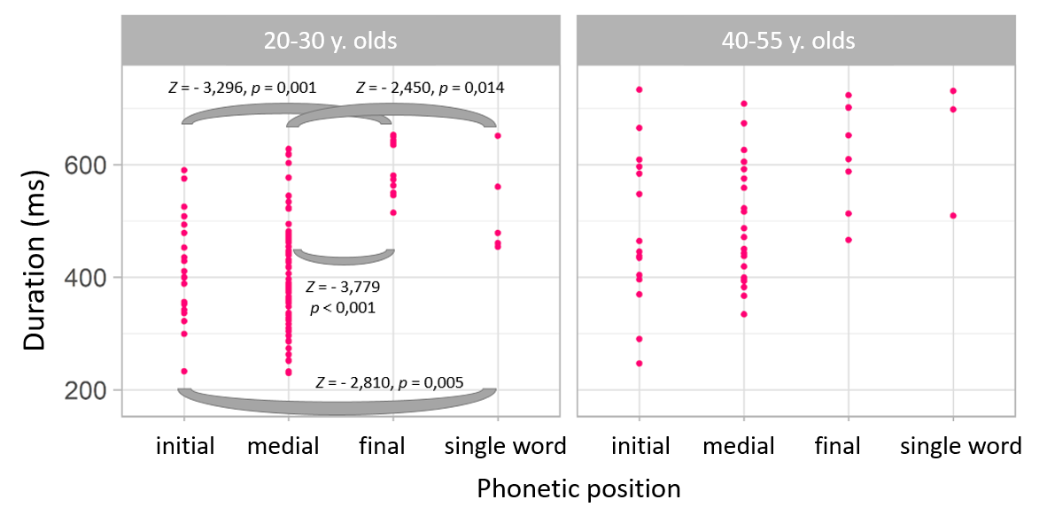
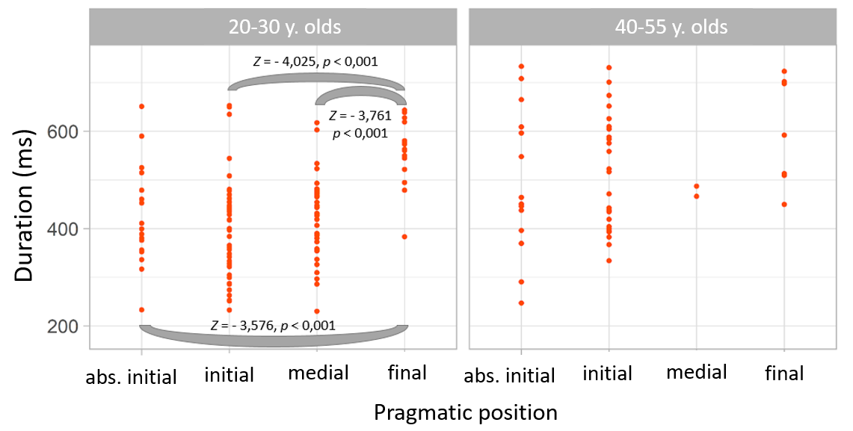
DURATION OF SZERINTEM ’I THINK’
Phonetic positions:
Longer duration in final position and in single-word IPU-s (phrase final lengthening) – significant differences: only in the group of 20-30 year olds
Pragmatic positions:
Longer duration in final position (pragmatic final position – most of the cases phonetic final position as well) – significant differences: only in the group of 20-30 year olds
Notes:
We analyzed the duration of szerintem: it can be seen the data according to the phonetic position on the left, and the pragmatic position, on the right in each cases grouped by the age.
The duration of szerintem was longer when szerintem occured in final phonetic position or occurred as a single word IPU in both age groups.
The duration of szerintem was longer in pragmatic final position, than in other pragmatic positions.
Significant differences were only found in the group of 20-30 years olds both in phonetic and pragmatic positions (significant differences are always marked on the figures).

Slide 13
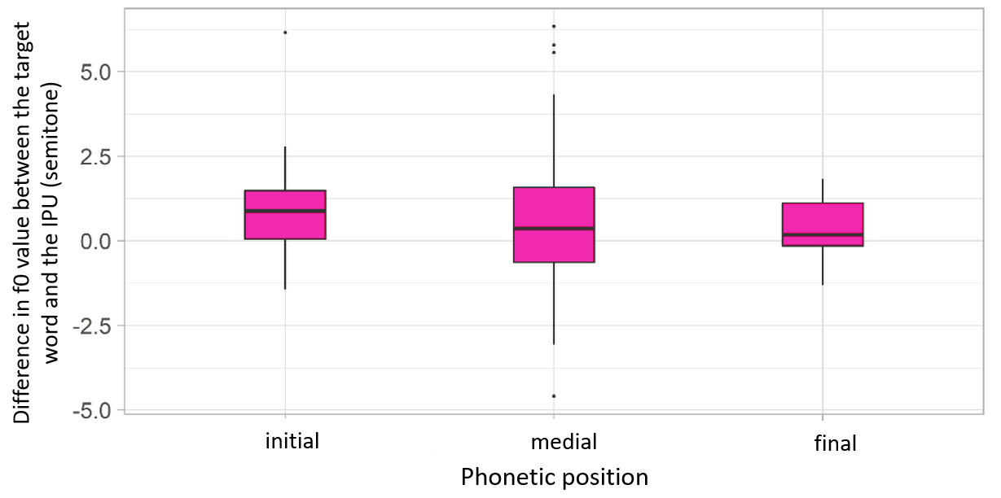
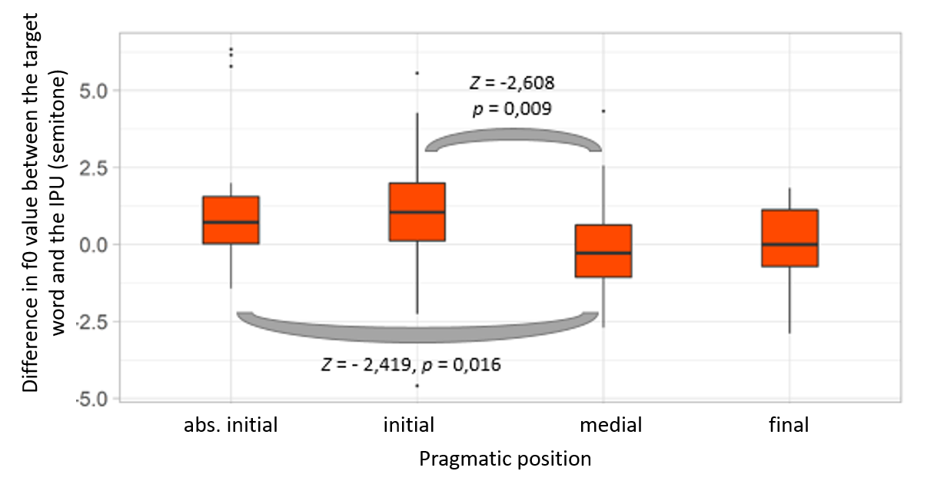
FUNDAMENTAL FREQUENCY (F0)
Phonetic position: no significant differences between the positions
Szerintem has a higher f0 in the initial position than the entire IPU has
Szerintem has the greatest f0-variability in the medial position
Pragmatic position:
Higher f0 in absolute initial and initial positions – possible reasons:
Different prosodic features can be connected to different pragmatic functions (in left periphery can be more subjective, in right periphery can be more intersubjective (Traugott 2014, de vö. Rhee 2020, Dér 2021)
Most of the cases it is at the beginning of the intonational phrase (e. g.: there is only one DM before szerintem)
Notes:
The relative fundamental frequency according to phonetic and pragmatic positions showed that (szerintem nem kell kitérni rá, de azért nem bontottuk korosztály szerint, m nem volt különbség az f0-alakulásban, míg az időtartamban volt).
the difference between the target word’s and the IPU’s f0:
if it is positive that means the f0 of the szerintem is higher than the f0 of the IPU (that contains the szerintem)
In the most of the cases when szerintem is in phonetic initial position the f0 of szerintem is higher than the f0 of the IPU
Furthermore, szerintem has the greatest variability in the phonetic medial position.
The f0 is higher in initial and absolute initial pragmatic positions than in medial or final, possible reasons can be: (bár a reason-öket lehet a colnculisonbe kéne)
Different prosodic features can be connected to different pragmatic functions (in left periphery can be more subjective, in right periphery can be more intersubjective)
Most of the cases it is at the beginning of the intonational phrase.

Slide 14
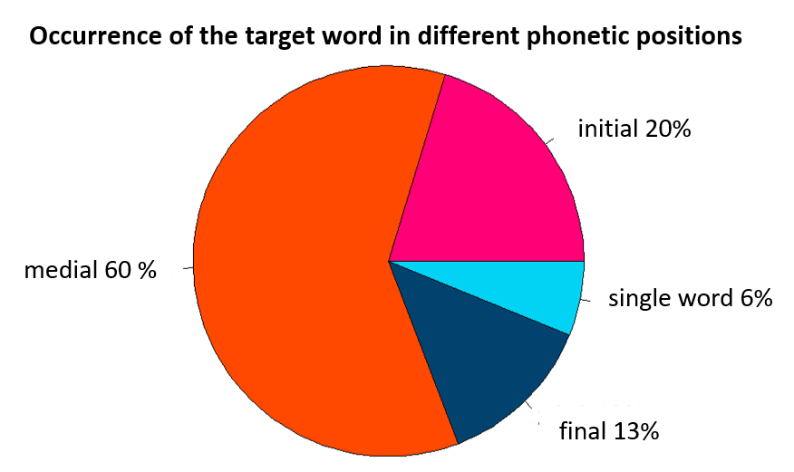
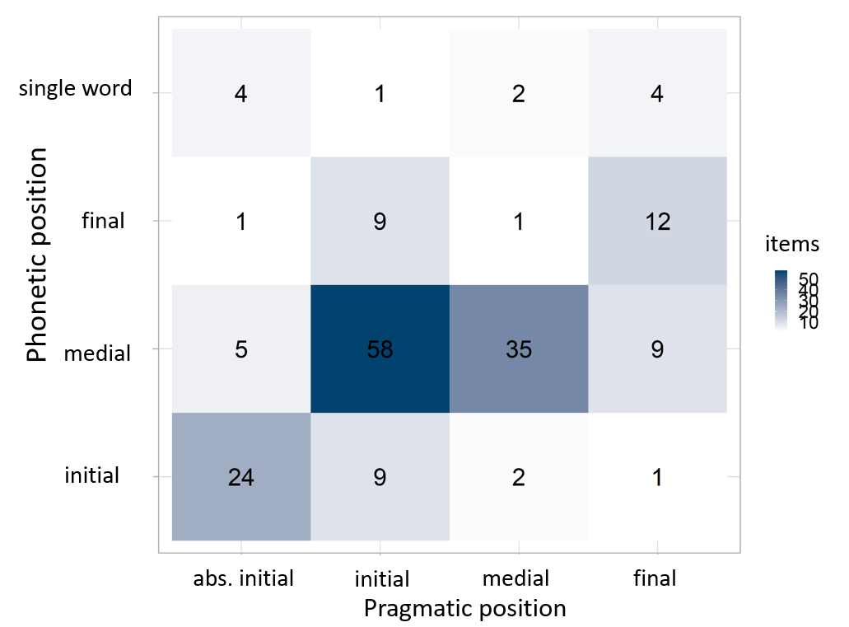
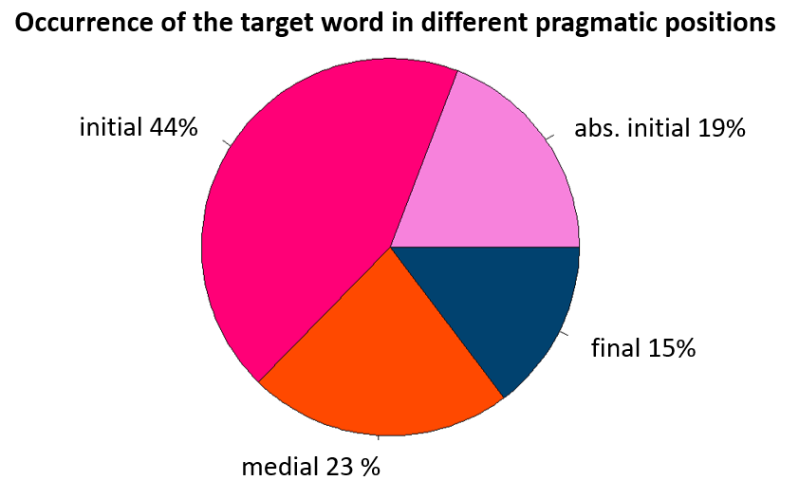
DISTRIBUTION IN PHONETIC AND PRAGMATIC POSITIONS
No prosodic independency: szerintem occurred in medial phonetic position (not surrounded by pauses) in 60%)
Phonetically initial (a pause before szerintem) and final (a pause after szerintem) position – only 20% of all cases
szerintem as a single word IPU – very low occurrence (6%) – mostly at absolute initial or final pragmatic positions
Szerintem mostly occurs in pragmatic initial (abs. init.: 19%, init.:44% -> 63%)
Lower occurrence in the other two positions (below 25%)
Absolute initial pragmatic position – mostly in phonetic initial position (there is a pause before szerintem)
Initial, medial pragmatic pos. – medial phonetic pos. (szerintem is not surrounded by silent pauses)
Final pragmatic pos. – final phonetic pos. (there is a pause after szerintem)
→ phonetic and pragmatic positions only partly coincide with each other
Notes:
On the next slide, you can see the occurrences of szerintem in phonetic positions (on the left) in pragmatic positions (on the right), and in both positions (in the middle).
As it is shown here, szerintem occurred mainly in phonetic medial position (so not surrounded with pauses, 60% of the cases) - that’s why we can say szerintem has no prosodic independency.
In the phonetic initial and final positions it occurs much rarely (not more than 20%)
in addition, the occurrence of szerintem as a single word IPU (surrounded with pauses) is very low (only 6%)
About the pragmatic positions:
Szerintem mostly occurs in pragmatic initial position (more than 60%), the occurrences are lower in the other two pragmatic positions (medial and final)
Phonetic and pragmatic positions only partly coincide:
szerintems with absolute initial pragmatic position mostly occur in initial phonetic position,
ininitial and medial pragmatic position mostly occur in medial phonetic position
and in final pragmatic position mostly occur in final phonetic posiotn

Slide 15
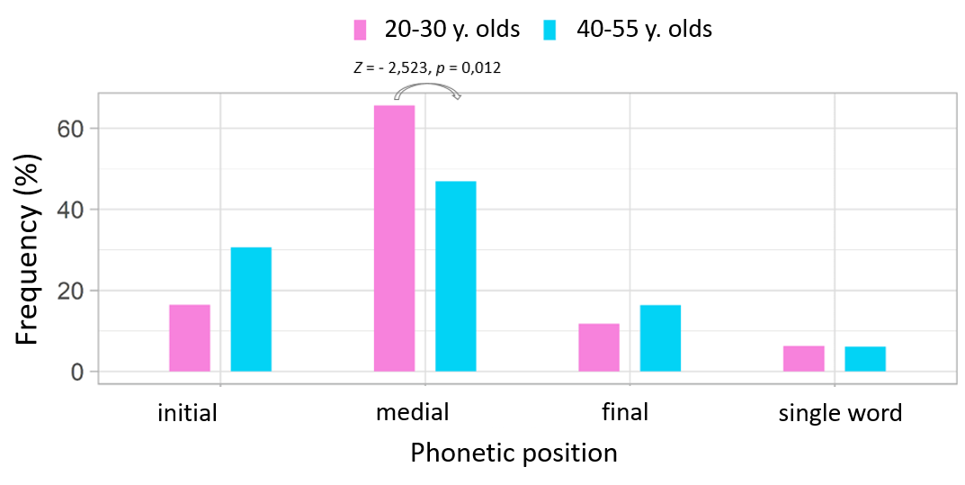
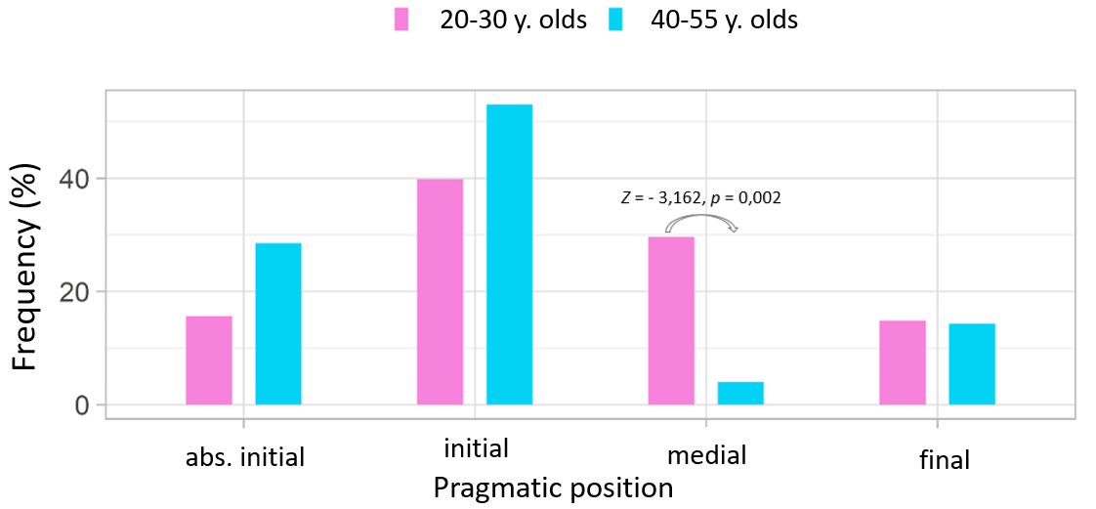
DISTRIBUTION REGARDING AGE
Phonetic position:
The medial position is frequent in both age groups but it is more frequent in the case of 20-30-year-olds (above 60%)
Initial position is more frequent in the case of 40-55-year olds
In the other two phonetic positions (final, szerintem as single-word IPU) there is no remarkable difference between the two age groups
Pragmatic position:
Absolute initial and initial positions are more frequent in the case of 40-55-year-olds
Medial position is more frequent in the case of 20-30-year-olds
No remarkable difference in final position between the two age groups
20-30-year olds use szerintem more frequently than 40-55-year olds ((χ²(3) = 13,509; p < 0,05)
Notes:
Here we can see the occurrence of szerintem regarding to age groups (on the left according to the phonetic position, and on the right the pragmatic position).
The medial position was frequent in both age groups but it was more frequently used in the case of 20-30-year-olds (above 60%), while szerintem occured in the more in the Initial position of 40-55-year olds.
In the other two phonetic positions (final, and szerintem as single-word IPU) there is no remarkable difference between the two age groups.
Regarding the pragmatic position?
Absolute initial and initial positions were more regularly used in the case of 40-55-year-olds, while 20-30-year-olds used medial position more often.
No notable difference was found in final position between the two age groups.
20-30-year olds use significantly more szerintem than 40-55-year olds.

Slide 16
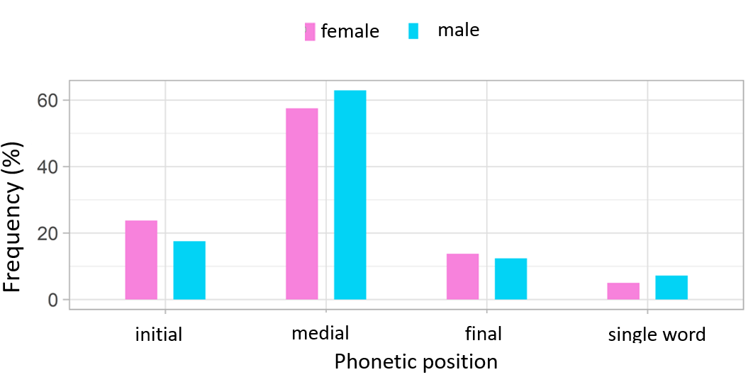
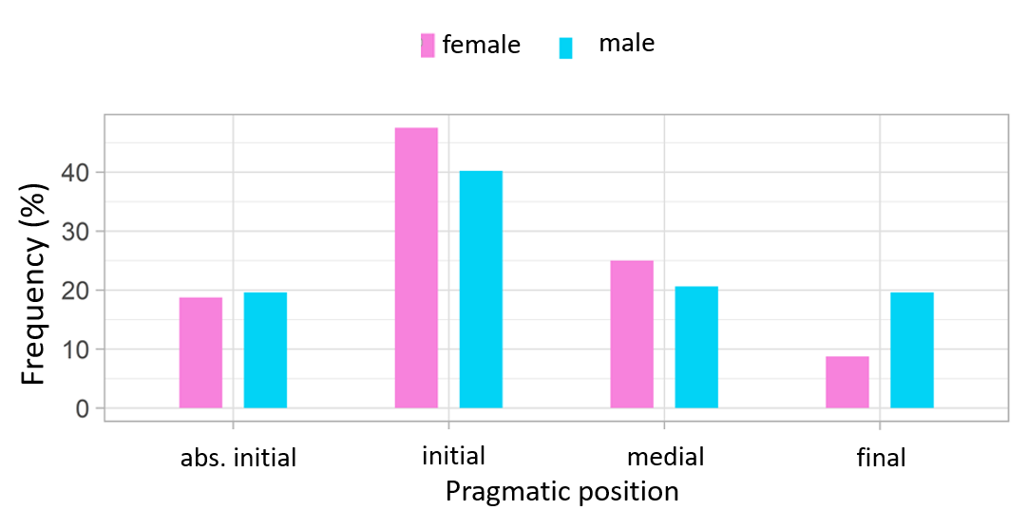
DISTRIBUTION REGARDING GENDER
Minimal differences in the frequency of szerintem in the different (phonetic and pragmatic) positions between females and males.
Notes:
The distribution regarding the gender was also analysed that can be seen on the present slide: on the left in the phonetic, and on the right in the pragmatic positions
Only minimal differences can be found between females and males, female speakers might use szerintem a bit more in initial pragmatic position, than male speakers (but in both group initial position is very frequent), and men used szerintem quite frequently in final pragmatic position than women (but this position is not a frequent position in neither group)

Slide 17
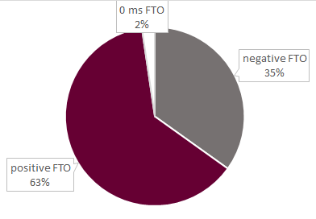
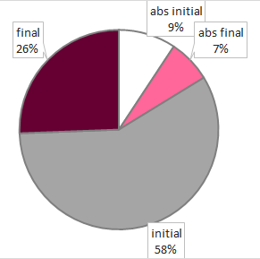
TURN TAKING & SZERINTEM
The distribution of FTO-values
24.3% of all szerintem occured in the near vicinity of a turn taking;
in most of the cases in the first IPU after the TT, but not in an absolute initial position e.g.
‘a tapasztalatok alapján szerintem ez volt azért nem volt az olyan gyakori’ (the first IPU after turn taking)
‘based on experience, I think it was not that common’
mean:
440 ms
mean:
416 ms
general distribution of the FTO types
most of them after/before positive FTO
less after/before negativ FTO
2% after/before 0 ms FTO
Notes:
Finally, we examined the relationship between the occurrence of szerintem and the positions of the turn-takings.
24.3% of all szerintem occured in the near vicinity of a turn taking, while the others realized in medial positions.
A turn taking could happen with a pause (so with positive FTO value), or with an overlap (so with negative FTO value)
The examined DM realized more frequently in the vicinity of a turn taking with positive FTO (those turn takings happened with a pause and not with overlap), as well as szerintem occurred more frequently in turn initial position than turn final but in one third of the cases szerintem appeared in turn final position,
so speakers use szerintem to pass the floor in most of the cases.

Slide 18
CONCLUSIONS
The age of the speaker influenced the occurrence of szerintem – more frequent in the younger speaker’s speech BUT the gender had no significant effect on the usage of the DM.
Szerintem is not phonetically independent.
On the left periphery, szerintem was preceded by another DM (e.g. hát ‘well’, igen de ‘yes but’) in more than 40% of all cases – szerintem in rather internal position not initial position.
Shift to medial pragmatic positions, e.g. ez szerintem teljesen morbid ‘it’s I think totally morbid’(bea034f020) – (syntactic) topic marker?
TT and szerintem: almost one quarter of all data occur near a turn-taking, most of them in the initial position in the first IPU after TT; two thirds of these turns occur with positive FTO (with a silent pause not overlap)
Notes:
To sum up:
The age of the speaker influenced the occurrence of szerintem: it was more frequent in the younger speaker’s speech BUT the gender had no significant effect on the usage of the DM.
Szerintem is clearly not phonetically independent.
On the left periphery, szerintem was preceded by another DM (e.g. hát ‘well’, igen de ‘yes but’) in more than 40% of all cases (this is what we call relative initial position) – szerintem in rather present internal position not initial position.
The "shifts" to medial (internal) pragmatic positions observed in the case of young people may be due to further pragmatisation of the DM, which is associated with an increase in its mobility (this was typically the case in the so-called tag phrase deletion grammaticalisation cases from noun to phrasal word/discourse marker, e.g. azt hiszem~asszem ‘I think’, kérem lit. I ask (you) ‘please’). In medial (internal) position, the segment boundary marker function (floor/turn-taking) of szerintem may be scarce, so it is conceivable that a new function develops in this internal position (in radio interviews, it takes the place after focus/topics in internal position, thus highlighting it, e.g. ez szerintem teljesen morbid ‘it’s I think totally morbid’).

Slide 19
REFERENCES
Aijmer, K. 1997. I think – an English modal particle. In: Swan, T. – Westvik, O. J. (eds): Modality in Germanic languages. Historical and comparative perspectives. Berlin: Mouton de Gruyter. 1–47.
Brinton, L. J. 2017. The evolution of pragmatic markers in English. Cambridge: Cambridge University Press.
Crible, L. 2018. Discourse markers and (dis)fluency. Amsterdam & Philadelphia: John Benjamins.
Dér, Cs. I. 2016. A szerintem diskurzusjelölő szinkrón és diakrón vizsgálata. In: Reményi Andrea Ágnes – Sárdi Csilla – Tóth Zsuzsa (szerk.) Távlatok a mai magyar alkalmazott nyelvészetben. Budapest: Tinta Könyvkiadó. 474-485.
Dér, Cs. I. 2018. A szerintem véleményjelölő a magyarban. In: Gecső Tamás — Szabó Mihály (szerk.): Egy- és többértelműség a nyelvben. Székesfehérvár — Budapest: Kodolányi János Egyetem — Tinta Könyvkiadó. 57-60.
Dér, Cs. I. 2020. Diskurzusjelölők és társulásaik a magyar nyelvben. Budapest: KRE — L’Harmattan.
Heine, B., Kaltenböck, G., Kuteva, T., Long, H. 2021. The rise of discourse markers. Cambridge: CUP.
Koczogh, H. V. 2012. The effects of gender and social distance on the expression of verbal disagreement employed by Hungarian undergraduate students. Doctoral dissertation. Debrecen: DE.
Kugler, N. 2015. Megfigyelés és következtetés a nyelvi tevékenységben. Budapest: Tinta.
Lam, Ph. W. Y. 2009. What a difference prosody makes: The role of prosody in the study of discourse particles. In Barth-Weingarten, D. – Dehé, N. – Wichmann, A. (eds.): Where prosody meets pragmatics. Emerald Book Publishing Limited. 107–128.
Mullan, K. 2010. Expressing opinions in French and Australian English Discourse. A semantic and interactional analysis. Amsterdam/Philadelphia: John Benjamins.

Slide 20
THANK YOU FOR YOUR ATTENTION!
The research was supported by the Hungarian National Research, Development and Innovation Office of Hungary [projects No. K-128810].
Hungarian Research Centre for Linguistics

Slide 21
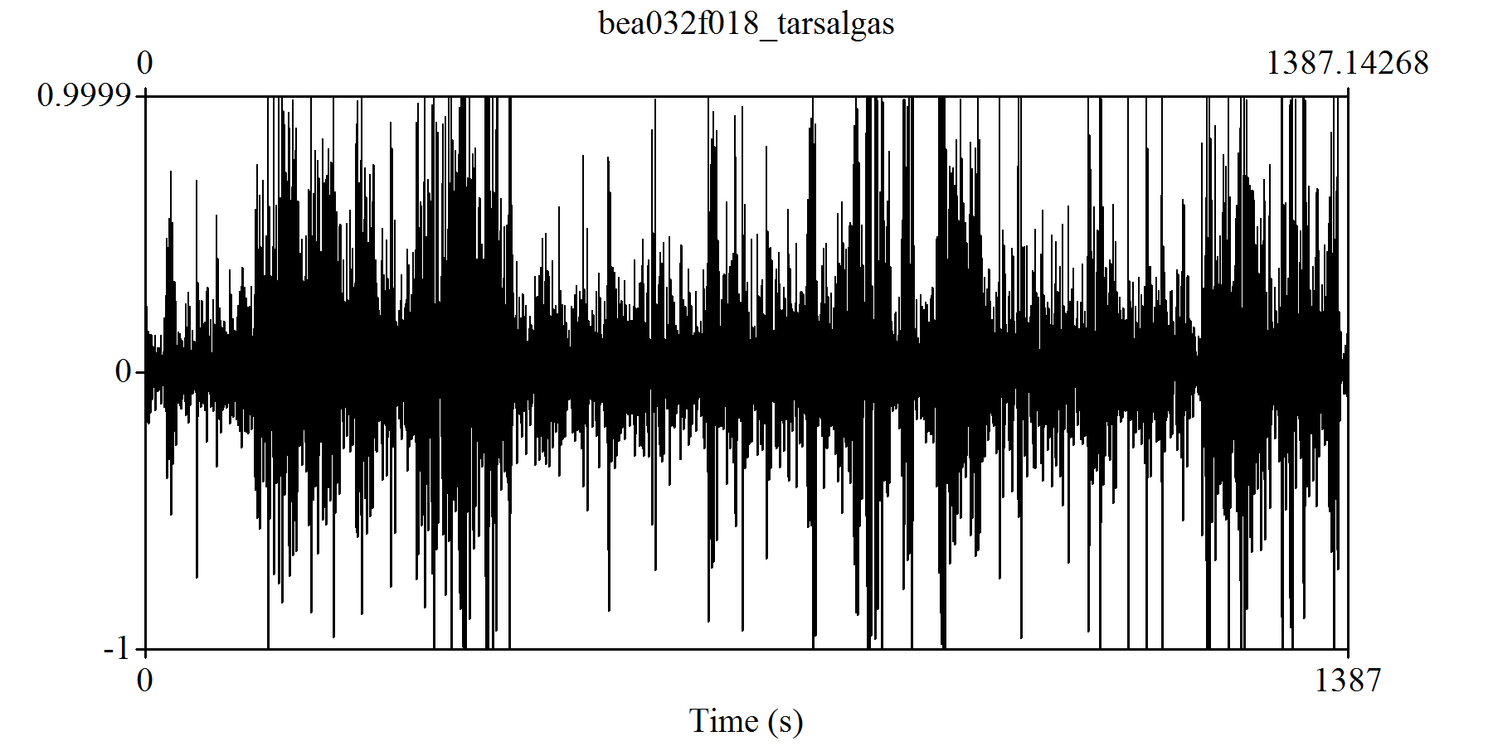
ANALYSIS
The occurrence of szerintem from dynamic aspect: splitting the recordings into equal parts (5 parts) + getting the data from each part; analysis of szerintem over time in the conversations
Advantage: the analysis is independent from the duration of the recordings (data are comparable)
Disadvantage: splitting the recordings independently from the conversational structure/function (may split coherent parts)
0-100%
(1387.1 s)
0-20%
(277.4 s)
21-40%
(277.4 s)
41-60%
(277.4 s)
61-80%
(277.4 s)
81-100%
(277.4 s)
Notes:
We analyzed the occurrence and realization (duration, F0) of szerintem regarding i) the position (phonetic and pragmatic position as well), the speaker’s age and gender. In addition, we analyzed the occurrence of szerintem from dynamic aspect with the following method.
We split each conversation into 5 equal parts using a Praat script as you can see it on the figure, and we analyzed the occurrence of szerintem in these 5 equal parts from the beginning of the conversation to the end. With this method, we can eliminate the the unequal durations of the conversations, and SO the conversations become comparable.

