Slide 1

Discourse variation analysis of the Hungarian interjections/discourse markers no~na ’now, so, well’ and their combinations with other markers and insubordinate clauses
International Conference on Historical Linguistics (ICHL) 2022
University of Oxford, 03. 08. 2022
Dér, Csilla Ilona (Hungarian Research Centre for Linguistics, Budapest)
Notes:
I added the word interjection to my title because I’d like to talk about the whole history and usage of no and na

Slide 2
Interjection (INT) as discourse marker (DM)?
the use of interjections as discourse markers (DMs): well researched area in many languages (e.g. Schiffrin 1987, Montes 1999, Norrick 2009, Roggia 2012)
the number of diachronic case studies is smaller (e.g. Onodera 2004), exp. true for interjections as DMs in Hungarian
Main aim: to clarify the functional and formal variations of na~no from the beginning until now
change of category? INT > DMs
Onodera (2004), Crible (2018), Schiffrin (1987): INTs can work as DMs
INTs: no semantic/referential meaning, no contribution to grammatical system, only expressive (Onodera 2004: 123)
1. Express the speaker’s inner sentiments, exclamation
2. Express the speaker’s communicative attention to draw sy’s attention or responding to sy. (e. g. Japanese ne, na, Onodera 2004: 124)

Slide 3
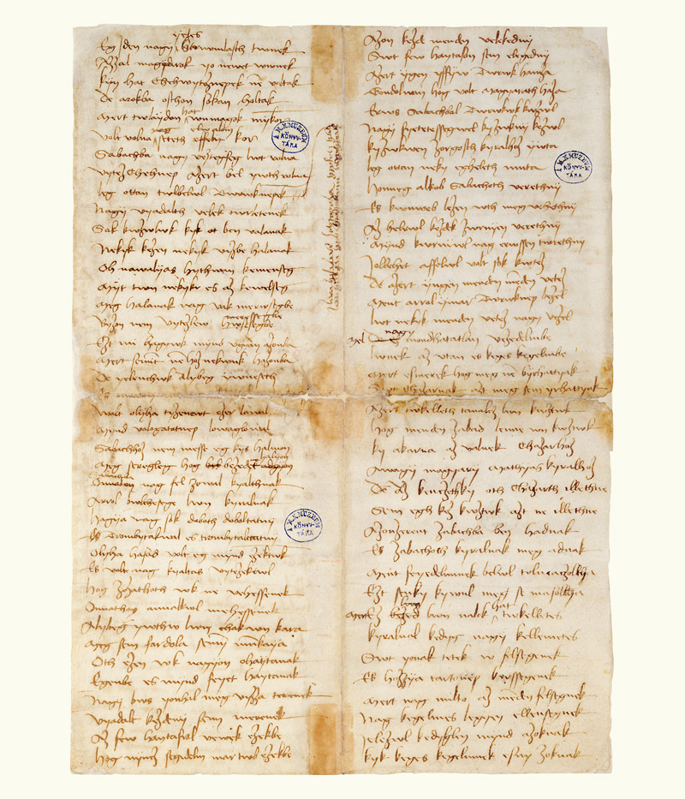
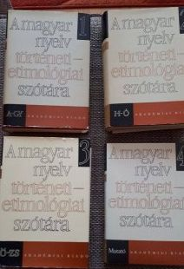
TESz. [Historical and Etymological Dictionary of the Hungarian Language, 1967]
Dictionary entry: no
1430k. SchlGl. 2235: eӱa nomar
[gloss]: no már ’come on’
1476k. SzabV. Nwaȝert
[narrative poem]:
nu(~no) azért ostromoltak kíméletlenül ’well they besieged mercilessly’
no > na
nu~no~noh
Notes:
In the Historical and… D. we find only one entry…

Slide 4
Dictionaries: main differences between no and na
Czuczor & Fogarasi (1861): A magyar nyelv szótára [Dictionary of Hungarian Language]
na is a regional dialectal variant of no
Pusztai (2003): A magyar nyelv értelmező szótára [Descriptive Dictionary of Hungarian Language]
Intonational: na „often merges into the next sentence” (cf. usage of comma in written Hungarian (no doesn’t?)
Functional: both have the same functions, except: na
  also has deictic (gestural&symbolic) usage: introducing close person, object:
Na, hát itt van a kaszárnya. ’Well/Now, here is the baracks’
  can introduce a new train of thought or summary (e.g. namármost ’well then’)

Slide 5
Main (overlapping) functions of no and na
Dictionaries mix the functions of INTs and DMs.
Pusztai (2003): only na is „folksy”
Expression of will, request (with or without urge): Na, gyerünk! ’Now, let’s go!’ No igyál! ’Well, drink!’
Related to a question as an urge, or to urge the answer: Na, mi lesz már? ’Oh, come on!’; No, gyere hát! ’Come on!’
As expressive and coloring words of emotional sentences (sedation, encouragement, praise, threat, frustration, worry, amazement, doubt, etc.): Na, mi jól megjártuk. ’Oh, we came off very badly.’; No persze! ’Of course!’
As an evocative word for the neutral (more) bridging details of a continuous narrative: Na de aztán egyszer csak… ’But then suddenly…’; No, ahogy mennek… ’Well, as they go…’
When saying goodbye, after the end of the conversation, to introduce the farewell formula: Na, szervusz. No, Isten veled. ’Well, good bye!’
(Folksy) As a response to an address: Na! Na. No. a) ’I hear you’; b) ’say what you want’.
Notes:
Highlighted in bold
Interpersonal, textual functions

Slide 6
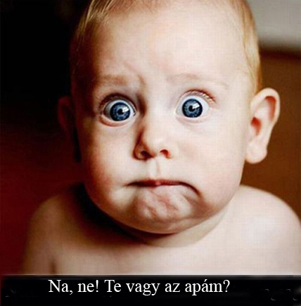
Main (overlapping) functions of no and na
Pusztai (2003): combinations, collocations: he lists DM-functions!
(Folksy) Na meg ’and of course’: to introduce a part connected to the sentence as an addition: Az ő passiója az alchimia volt, na meg … az udvar szobacicusai. ’His passion was alchemy, and… the yard cats’
Na mármost ’Well, now’: introductory formula for a new thought of line or as introduction to a summary: Na mármost képzeljük el, hogy… ’Now imagine that…’
No meg ’and of course’: after detailing, to introduce the addition of the missing detail, often in the sense that it is less important: Vettem húst, káposztát, tejfölt, no meg kaprot. ’I bought meat, cabbage, sour cream, and dill.’
No és? ’So what?’ – introducing a mock question
’Oh, no (come on!)!
You are my father?’

Slide 7
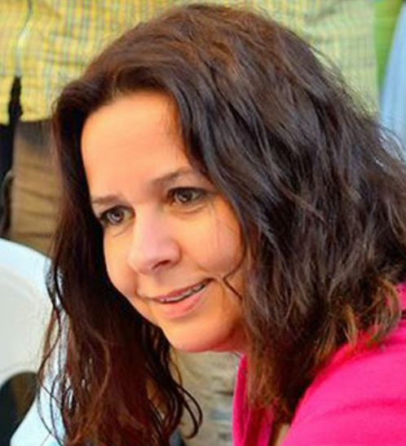
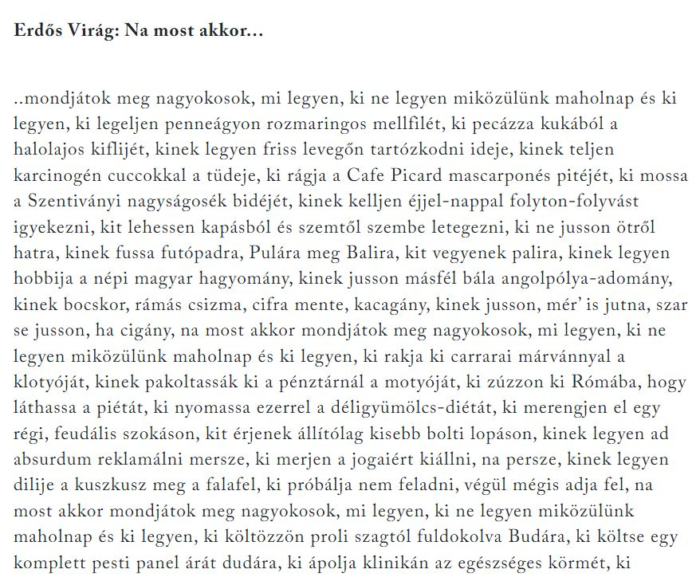
Erdős Virág: Na most akkor ’Now then’
’now then/right then
tell me you wiseguys
what to do
who shouldn’t be among us nowadays
and who should be’
Call attention+topic-starting
spoken language
na persze ’oh sure’
Source: https://cultura.hu/kultura/vers-a-hetre-erdos-virag-na-most-akkor/
https://litera.hu/irodalom/elso-kozles/az-ev-verse-erdos-virag-na-most-akkor.html
Notes:
Political poetry, social criticism

Slide 8
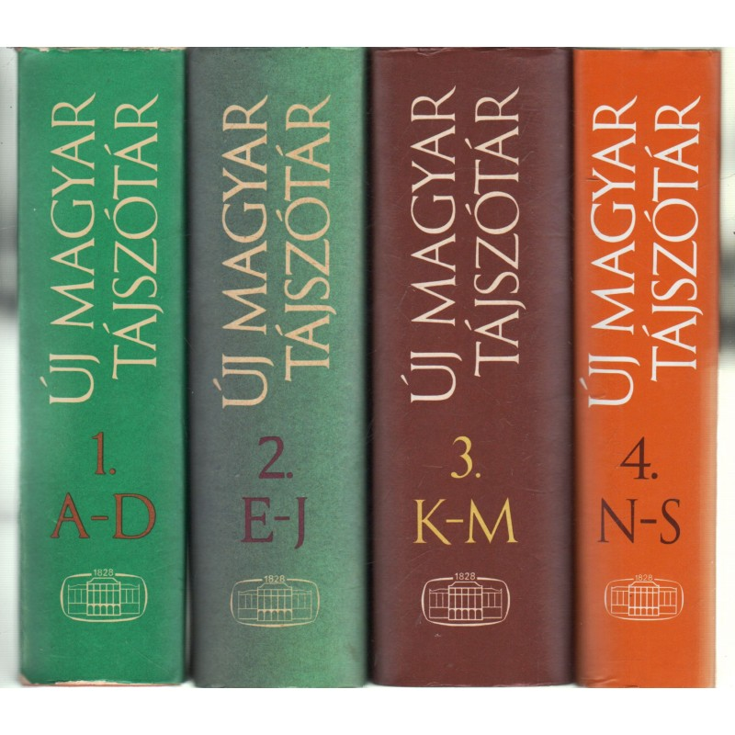
ÚMTSz. [New Dictionary of Hungarian Regional Variants, 1950–2010]
No: northeastern dialectal region (Őrhalom, Debrecen, Tiszacsege, etc.) – source of Standard Hungarian Language
Na: in different regions (Mezőség, Közép-Dunántúl, Tisza-Körös vidéke, Dél-Alföld)
1. Na akkor~nakkó! ’well then’ [DM-function: starting a new sequence/topic+call attention]
2. Expression of will and different emotions (surprise, approval): Na! Na-na!
3. Animal herding and calling expression: Na! Na, na! Na-ne! Na, gyí! (starting and driving horse, cattle)

Slide 9
Corpora, method
ÓMK = Ómagyar Korpusz [Old Hungarian Concordance]. 1192–1526. Genres. Size: 3.2 million word tokens. http://omagyarkorpusz.nytud.hu/en-search.html
TMK = Történeti Magánéleti Korpusz [Historical Corpus of Personal Life, ]. End of the 15th c.–1772. Genres: witness testimonies of witch trials and private letters. Size: 1 million word tokens. http://tmk.nytud.hu/3/ (Dömötör et al. 2017)
MTSz = Magyar Történeti Korpusz [Hungarian Historical Corpus]. 1772–2010. Genres/registers: fiction and press language, legal, professional, personal texts, Size: 30 million word tokens. http://clara.nytud.hu/mtsz/run.cgi/first_form
BEA = Magyar Spontán Beszéd Adatbázis [Hungarian Database of Spontaneous Speech]. Subcorpora of 30 conversations with 3 speakers (Budapest). Size: ~8 hours long. http://www.nytud.hu/adatb/bea/index.html [gender, age]
MNSz2 = Magyar Nemzeti Szövegtár 2. változat [Hungarian National Corpus 2.0.5]. Size: 1.04 billion tokens. http://clara.nytud.hu/mnsz2-dev/ [subcorpora by regions (Hungary, Slovakia, Subcarpathia, Transylvania, Vojvodina), by registers (spoken press language –news&reports, written press language, fiction, academic, political, private) (Oravecz et al. 2014, http://clara.nytud.hu/mnsz2-dev/stat.html)
Method: Discourse variation analysis (Pichler 2010, 2013)
Notes:
I attempted to uncover

Slide 10
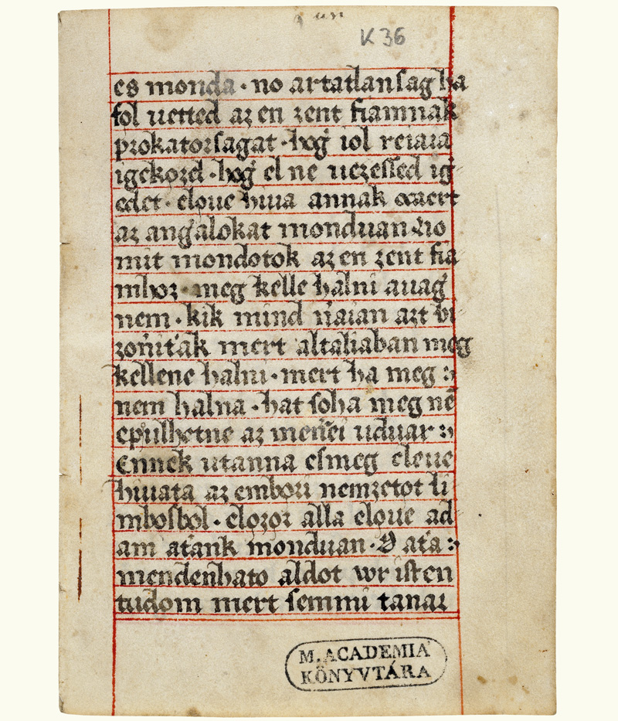
Old and Middle Hungarian Period (ÓMK & TMK: 12–18. cent)
No: data from the 15th century
ÓMK: 39 valid hits (mostly in no azért ’well, …though’ combination), first data:
(1) Piry Hártya (end of the 15th c.) - 1 - 1/82798: es monda. no artatlanſag ha fo̗l uetted az en zent fiamnak prokatorſagat…’and he said. well, innocence if you took up my son's defense’
351 valid hits in TMK: frequent in witchcraft trial texts: as threats (no várrá ’just wait’)
(2) no te kutya var reá, mert eszt megh emlegeted, verrel fogsz ezért okadni
’well, you dog, wait, you’ll regret this, you’ll womit blood for it ’ (Bosz. 306, 1726)
No + name/swearing + threat
Position: only on the left periphery, first position
Na: data from the end of the 17th c., no valid hit in ÓMK, only 5 valid hits in TMK (Heves, Zala, Zemplén, Komárom, Bihar county): predicates in indicative, no combinations/collocations
(3) halotta az biro hazanal hogi na ianos nezol mondota heuesi andrasnenak hogi te celeketed enne… az niavaliat miuel hogi köztekben nem altam.
’He heard at the judge's house that, now, János, you look, she said to András Hevesi, that your actions would eat… the illness, since I was not among you’ (Bosz. 163. Komárom county, Ekecs, 1631)
Position: left p.

Slide 11
New Hungarian Period (MTSz, 18–20. cent.): no
6933 hits, frequent in letters, autobiographies, fiction
Typical position: left periphery, first element
But: on the right periphery after imperatives: very rare
(4) Erzsike.: Julcsa te! – megállj no! ’Liz: Julcsa, you! – just stop!’ (MTSz, Szigligeti Ede: A lelenc, 1863: 37)
Typical collocations (based on logDice):
1847: no lám ’well, well’ (9.057) – pers.
1777: no hát ’well then’ (8.209) – pers., press, fiction
1847: no persze ’sure’ (7.449) – fiction, terminology
(5) AKARÓ. No hát jere édes úti-társ és ballagjunk ekképpen ketten együtt ’
Well, come, my dear fellow-traveller, and let's go together like this’ (Szigeti Gyula Sámuel – Tordai Sámuel: Keresztyén utazás a bóldog örökké-valoságra, 1777: 7)

Slide 12
New Hungarian Period (MTSz, 18–20. cent.): na
4241 hits, its use increases from the 1910s (mostly in fiction, in dialogs)
Typical collocations (logDice): most of them are DMs:
na+hát (logDice: 6.558): from 1793, total 62 hits, % from the 20th century
(6) VILHELM.: Na hát tsak rajta; folytaſſad te ſzomoru, bé zárt fülemile! énekléſedet. ’Well then, go on with your sad singing, caged nightingale’ (MTSz, Boér Sándor: Ki légyen oͤ? 1793.2: 170)
Na hát > nahát (frequent from the 20th c.)
(7) – Ugy-e kincsem, azt akarja mondani, hogy magának nincs? – Ejnye beh eltalálta;.. bizony ördöge van. – Nahát van nekem. ’Are you saying, my treasure, you don't have any? – How could you figure it out, you’re right. – Well, I have it.’ (Bernát Gáspár: Kávé cuzpájz, 1857: 40)
From 1865: na+jó ’well, okay’
From the end of the 19th century: na+ja ’well, yeah’, na+persze ’of course, sure’
from the 20th century: na+látod ’now you see’; na ugye ’oh right’

Slide 13
Today’s Hungarian:
MNSz2: variation across genres/registers: no
Genre/register | Absolute frequency of no (hits) | Relative frequency of no | Size of subcorpus (million tokens) | Occurence of no (per token)
Written press (journalism) | 7263 | 12.96% | 364.8 | 0.0000199095
(Transcribed) spoken press | 644 | 1.15% | 76.2 | 0.0000084514
Private (internet forums) | 8297 | 14.80% | 57.9 | 0.0001432988
Private (social media) but: duplicates! | 28907 | 51.56% | 243.2 | 0.000118861
(Popular) science) | 5311 | 9.47% | 117.9 | 0.0000450466
Political/Official | 1649 | 2.94% | 99.0 | 0.0000166566
Fiction/Literature | 3990 | 7.12% | 80.6 | 0.0000495037
Total | 56061 | 100,00% | 1039.7 | 0.0000539204
Notes:
Very frequent in written spoken language, mostly in internet forums and social media texts, and interestingly is very rare in spoken (press) language (radio programs, typically interviews).
Divide the nr of hits by the nr of nr of tokens

Slide 14
Today’s Hungarian:
MNSz2: variation across genres/registers: na
Genre/register | Absolute frequency of na (hits) | Relative frequency of na | Size of subcorpus (million tokens) | Occurence of na (per tokens)
Written press (journalism) | 5358 | 7.05% | 364.8 | 0.0000146875
(Transcribed) spoken press | 5793 | 7.63% | 76.2 | 0.0000760236
Private (internet discussion forums) | 13482 | 17.76% | 57.9 | 0.0002328497
Private (social media) – but: duplicates! | 40725 | 53.65% |  | 0.0001674548
 |  |  | 243.2
(Popular) science) | 3228 | 4,25% | 117.9 | 0.0000273791
Political/Official | 2950 | 3,89% | 99.0 | 0.000029798
Fiction/Literature | 4373 | 5.77% | 80.6 | 0.0000542556
Total | 75909 | 100,00% | 1039.7 | 0.0000730105
Notes:
Na is also the most frequent in the private subcorpora but much more common than no in the same corpus

Slide 15
Today’s Hungarian:
MNSz2: variation across regions: no
Region | Absolute frequency of no (hits) | Relative frequency of no | Size of subcorpus (million tokens) | Occurence of no (per token)
Hungary | 53945 | 96.25% | 1013.9 | 0.0000532054
Slovakia | 1005 | 1.79% | 17.3 | 0.0000580925
Subcarpathia | 265 | 0.47% | 2.5 | 0.000106
Transylvania | 585 | 1.05% | 3.9 | 0.00015
Vojvodina | 261 | 0.46% | 2.0 | 0.0001305
Total | 56061 | 100,00% | 1039.7
Notes:
As for the regions: both no and na is the most numerous in 3 subcorpora, no in Transylvania, followed by the Vojvodina and Subcarpathia region

Slide 16
Today’s Hungarian:
MNSz2: variation across regions: na
Region | Absolute frequency of na (hits) | Relative frequency of na | Size of subcorpus (million tokens) | Occurence of na (per token)
Hungary | 73131 | 96.35% | 1013.9 | 0.0000721284
Slovakia | 1415 | 1.86% | 17.3 | 0.0000817919
Subcarpathia | 555 | 0.73% | 2.5 | 0.000222
Transylvania | 599 | 0.79% | 3.9 | 0.0001535897
Vojvodina | 209 | 0.27% | 2.0 | 0.0001045
Total | 75909 | 100,00% | 1039.7
Notes:
Na in Subcarpathia, Transylvania and Vojvodina

Slide 17
Regions x registers
Outstanding regions outside Hungary: Subcarpathia, Vojvodina, Transylvania
Na and no is also frequent, but in what registers?
Subcarpathia:
no: pers.forum (75,08%), written press (13,16%)
na: pers.forum (93,89%)
Vojvodina:
no: written press (daily/weekly newspaper) (61,88%), science (27,15%)
na: written press (61,20%), pers.forum (19,34%)
Transylvania:
no: pers.forum (58,47%), science (21,28%, but: most of them are not valid hits), fiction (11,05%)
na: pers.forum (90.24%)
Notes:
These 3 outstanding regions show a different picture if we also include the genre aspect: Vojvodina is the most interesting because both no and na typically occurs in written press/journalism, not in internet forums

Slide 18
Insubordinate clauses starting with no~na + HOGY ’that’ in MNSz2
„When a clause follows an interjection, such a clause conveys the verbal version of the speaker’s sentiment expressed by the interjection.” (Onodera 2004: 53, cf. Gallasy 1991, 1992)
Insubordinate clauses often carry emotional emphasis, express negative emotions – no, na fits into this because of their emotional charge (as do swear words)
No + hogy: 8 valid hits (all from Hungary, personal subcorpus), 3 types (evaluation, deontic, elaborative insubordination, D’Hertefelt 2018)
(8) No hogy mik vannak! ’You don’t say!’ (lit. well that what [kind of things] are) (MNSz2, #958829717,doc#2668, Hungary, pers.soc)
(9) 2: ismeretségi spektrum: no hogy ez honnan jutott eszembe: ültem a trolin és hallgattam a sulis gyerkőcöket amint az öket érdeklő eseményeket analizálták ... ’2: acquaintance spectrum: how did I come up with this: I sat on the trolley and listened to the school children analyzing the events that interested them’(MNSz2, #93366988, doc#989, Hungary, pers.forum)
Notes:
Mostly all from the personal subcorpus

Slide 19
Insubordinate clauses starting with no~na + HOGY ’that’ in MNSz2)
Na + hogy: 40 valid hits (all from Hungary, 1 from Subcarpathia, personal subcorpus, except 6 hits: 2 from lit, 1 from written press, 3 from spoken press language, 70% elaborative, 25% deontic/curses):
(10) 2013-11-23 Szénási Szabina na hogy venné el azokat az embereket akik velem vanak elfoglalva’ 2013-11-23 Szabina Szenási, that you could take away those people who are busy with me’(MNSz2, #1187282345, doc#2889, Hungary, pers.soc)
(11) 10/14/99 16:25:20 Na hogy legyen egy temaba vago hozzaszolas is… ’To add something to the topic…’ (MNSz2, #120376680, doc#1013, Hungary, pers.forum)

Slide 20
Collocations in MNSz2 (logDice)
collocations with na | meaning | Typical genre, region | collocations with no | meaning | typical genre, region
na ja (8.013) | ’well, yeah’ | pers Hungary | no lám (6.955) | ’well, well’ | pers.forum, lit Hungary, Vojvodina
na mindegy (8.006) | ’whatever’ | Hungary Pers | no persze (5.507) | ’sure’ | pers.forum, Hungary, Vojvodina
na jo (6.902) | ’well, okay’ | Hungary pers.forum | no hiába (4.271) | ’well, for nothing’ | pers.forum
na jó (6.558) | ’ okay, all right’ | Hungary, pers
na tessék (6.502) | ’here we go/there you go’ | Hungary, pers | no jo (3.964) | ’oh well’ | pers.forum
na most (6.326) | ’well, now/then’ | Hungary, spoken press | no hát (2.765) | ’well then’ | spoken press, pers.forum
na hát (6.248) | ’well (then)’ | Hungary, Subcarpathia, spoken press, pers.soc | no ja (2.325) | ’well yeah’ | pers
 |  |  | no most (1.866) | ’well, now’ | pers.forum, lit
Notes:
The most important result in the case of collocations: both can have the same collocate word but one construction is more typical than the other one (na jó vs. no jó, na most vs. No most, na hát vs. No hát)
Descencing order depending on the value of logDice

Slide 21
BEA: spontaneous conversations, only speakers from Budapest
30 conversations with 3 participants (everyday topics), 7’44” = 37129 words
A (main speaker, 15 women &15 men, 20–71 ys, 3 age groups: 20–35 ys /youngsters/, 36 – 50 ys /middle-aged/, 51–71 ys /older speakers/ - in each groups: half are male, half female)
T1 (experiment leader, mostly the same woman, 29 ys)
T2 (conversational partner, 2 men, 2 women in their 20s)
No occurence of no!!!
Na: 166 total hits
A: 73 hits, 38,35% (men) vs. 61,65% (women)
Ratio per word number (nr of hits / nr of words)
There was no significant gender (Mann-Whitney test: p>0.05, U = 94000) and age difference (ANOVA: p>0.05, F= 2.077, df=2)
Notes:
The most surprising result I’ve got in BEA corpus because there was no single hit of no!

Slide 22
MEN |  |  |  |  | WOMEN
speaker | agegroup | nr of words | NA | NA/nr of words | speaker | agegroup | nr of words | NA | NA/nr of words
bea032 | <= 35 | 1303 | 1 | 0.000767 | bea037 | <= 35 | 1171 | 0 | 0
bea031 | <= 35 | 1729 | 5 | 0.002891 | bea010 | <= 35 | 1435 | 2 | 0.001393
bea040 | <= 35 | 921 | 1 | 0.001085 | bea017 | <= 35 | 575 | 0 | 0
bea018 | <= 35 | 1319 | 0 | 0 | bea044 | <= 35 | 1266 | 1 | 0.000789
bea029 | <= 35 | 429 | 0 | 0 | bea019 | <= 35 | 2318 | 11 | 0.004745
bea039 | <= 35 | 1603 | 5 | 0.003119 | bea062 | <= 35 | 1847 | 2 | 0.001082
bea002 | <= 35 | 1374 | 0 | 0 | bea003 | 36 - 50 | 732 | 3 | 0.004098
bea013 | 36 - 50 | 2438 | 10 | 0.004027 | bea035 | 36 - 50 | 1550 | 3 | 0.001935
bea012 | 36 - 50 | 854 | 2 | 0.002341 | bea041 | 36 - 50 | 613 | 1 | 0.001631
bea026 | 36 - 50 | 420 | 2 | 0.004761 | bea020 | 51+ | 1500 | 4 | 0.002666
bea025 | 51+ | 350 | 0 | 0 | bea046 | 51+ | 1941 | 0 | 0
bea021 | 51+ | 1580 | 0 | 0 | bea015 | 51+ | 2003 | 3 | 0.001498
bea038 | 51+ | 533 | 1 | 0.001876 | bea011 | 51+ | 1484 | 5 | 0.003369
bea014 | 51+ | 1050 | 1 | 0.009523 | bea009 | 51+ | 730 | 3 | 0.004109
bea070 | 51+ | 1251 | 0 | 0 | bea023 | 51+ | 810 | 6 | 0.007407
 |  |  | mean | 0,00206 | < |  |  | mean | 0002315
Notes:
In this table the most important column is coloured by purple, the means of men and women show only a slight different from each other

Slide 23
BEA: spontaneous conversations
Single na: only 15 hits!
Na likes to combine (79.45%)
Na most (hát/akkor): 12 hits
Na jó (de/hát/mondjuk/szóval): 8 hits
Na hát (akkor/aztán): 8 hits
Notes:
Almost 80% in the case na was combined with another DM

Slide 24
BEA: examples of DM-combinations
(12) back to main topic + highlighting
A: én speciel minden vagyok csak egy olyan futó alkat nem na most anyukám meg főleg nem
’I’m anything but a running figure, well, my mom especially not’ (bea019, female, 32)
(13) reformulation
A: mer én szoktam mondani ’because I used to say’
T1: ühüm ’uhm’
A: hogy jó hát fél óra alatt ’it’s okay in half an hour’
T1: ühüm ’uhm’
A: elolvasod na jó egy óra (bea062, female, 35) ’you can read it, okay, in an hour’

Slide 25
Conclusions
Na appeared a 100 years later than no as a dialectal variant of it
Na is clearly not a regional variant anymore, it’s more frequent than no in many genres
Both form is very common in Transylvania, Vojvodina and Subcarpathia, esp. in press language and internet forum texts
No was missing from spontaneous conversations (speakers of Budapest) and was very rare in spoken press language (journalism, MNSz2) → written press language, written spoken (internet) language
Na collocates more, is more pragmaticalized than no
Both have DM-functions, they can collocate or build a complex construction (e.g. nahát, nohiszen) with DMs
Na and no prefer different collocate words, speakers typically use one construction over another (na jó, na most, na hát, na de, but: no lám)
Na showed no gender or age differences in conversations (speakers of Budapest)
INTERACTIONAL FUNCTIONS: sequential (speech-segmenting: opening boundary, topic-management) & interpersonal (/dis/agreeing) functions (cf. Crible 2018: English, French)

Slide 26


Acknowledgements
This research was supported
by the project NKFI FK 135186 (Variation in Middle Hungarian: a register perspective) and
by the Bolyai János Research Grant (BO/00191/21/1).

Slide 27
THANK YOU VERY MUCH FOR YOUR ATTENTION!

Slide 28
References
Crible, Ludivine 2018. Discourse markers and (dis)fluency. Amsterdam–Philadelphia: John Benjamins.
D’Hertefelt, Sarah. 2018. Insubordination in Germanic: A typology of complements and conditional constructions. Berlin: De Gruyter
Dömötör, Adrienne – Gugán, Katalin – Novák, Attila – Varga, Mónika 2017. Kiútkeresés a morfológiai labirintusból – korpuszépítés ó- és középmagyar kori magánéleti szövegekből. NyK 113: 85–110.
Gallasy, Magdolna 1991. Az indulatszók. [Interjections] In Benkő Loránd–E. Abaffy Erzsébet–Rácz Endre (szerk.) A magyar nyelv történeti nyelvtana I. A korai ómagyar kor és előzményei. Budapest: Akadémiai Kiadó. 514–522.
Gallasy, Magdolna 1992. Az indulatszók. [Interjections] In: Benkő Loránd, E. Abaffy Erzsébet, Rácz Endre (szerk.) A magyar nyelv történeti nyelvtana II/1. A kései ómagyar kor. Morfematika. Budapest: Akadémiai Kiadó. 839–852.
Montes, Rosa Graciela 1999. The development of discourse markers in Spanish: Interjections. Journal of Pragmatics 31(10): 1289–1319.
Norrick, Neal R. 2009. Interjections as pragmatic markers. Journal of Pragmatics 41(5): 866–891.
Onodera, Noriko 2004. Japanese discourse markers. Synchronic and diachronic discourse analysis. Amsterdam – Philadelphia: John Benjamins.
Oravecz, Csaba – Váradi, Tamás – Sass, Bálint 2014. The Hungarian Gigaword Corpus. Proceedings of LREC 2014. 1719–1723.
Pichler, Heike 2010. Methods in discourse variation analysis: Reflections on the way forward. Journal of Sociolinguistics 14: 581–608.
Pichler, Heike 2013. The structure of discourse-pragmatic variation. Amsterdam–Philadelphia: John Benjamins.
Pusztai, Ferenc (ed.) 2003. Magyar értelmező kéziszótár. Budapest: Akadémiai Kiadó.
Roggia, Aaron B. 2012. Eh as a polyfunctional discourse marker in Dominican Spanish. Journal of Pragmatics 44(13): 1783–1798.
Schiffrin, Deborah 1987. Discourse markers. Cambridge: Cambridge University Press.

Slide 29
MNSz2 (v 2.0.5) – sizes of subcorpora (million words)
 | Hungary | Slovakia | Subcarpathia | Transylvania | Vojvodina | total
Written press | 350.5 | 11.6 | 0.7 | 0.6 | 1.5 | 364.8
Fiction | 77.0 | 2.3 | 0.4 | 0.8 | 0.2 | 80.6
Science | 112.0 | 3.3 | 0.7 | 1.6 | 0.3 | 117.9
Official/ Political | 98.0 | 0.2 | 0.3 | 0.6 | 0.1> | 99.0
Personal | 300.3 | – | 0.4 | 0.4 | 0.1> | 301.1
Spoken press | 76.2 | – | – | – | – | 76.2
Total | 1013.9 | 17.3 | 2.5 | 3.9 | 2.0 | 1039.7

Slide 30
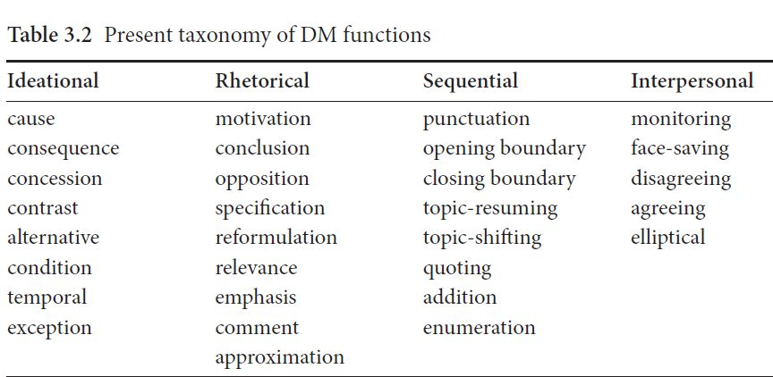
Crible (2018: 47)

